Slide 1
Java

Slide 2
Instructions
Stay on Camera
Only use RPS Cloud for code
No Personal Git Account
Be interactive in session
Do hands on and upload them on git on daily basis.
Join the session on time.
Attendance is recorded and tracked by team

Slide 3
Features of Java
Object Oriented
Follows the object-oriented paradigm
Portable
Execute the Java program on every machine.
Platform Independent
Comes with Java platform where java can execute
Robust
Strong memory management
MultiThreaded
Doesn't occupy memory for each thread.
Distributed
Access files by calling the methods from any machine on the internet.
Interpreted
Just-in-time (JIT) interpreter along with the compiler
Dynamic
Supports dynamic loading of classes.
Architectural Neutral
Not dependent on the architecture.

Slide 4
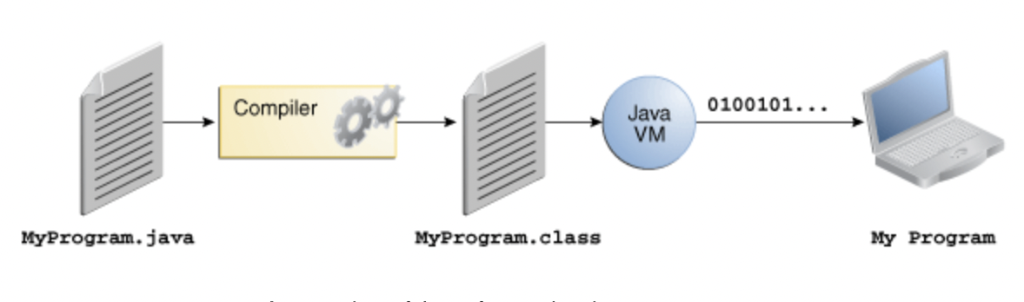
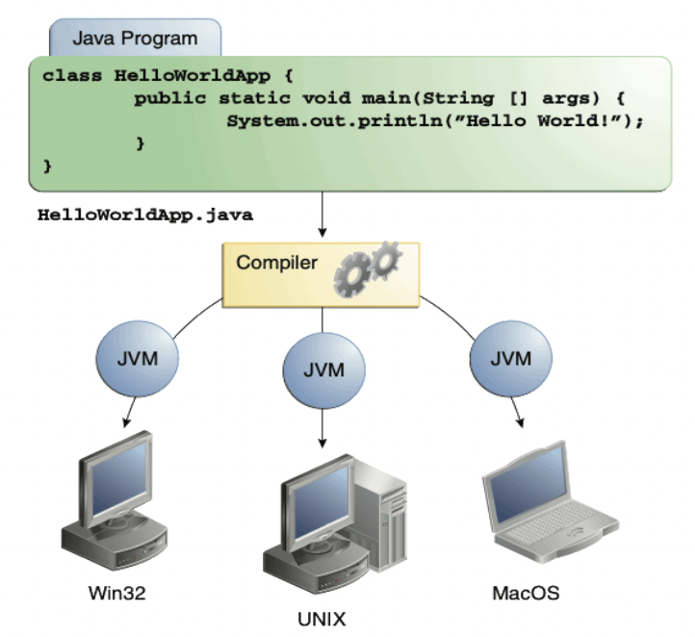
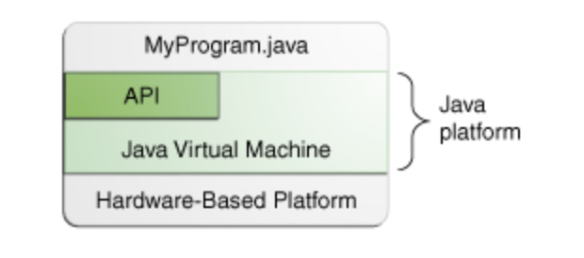
Platform Independent
A platform is the hardware or software environment in which a program runs.
Platforms can be described as a combination of the operating system and underlying hardware.
The Java platform has two components:
The Java Virtual Machine
The Java Application Programming Interface (API)

Slide 5
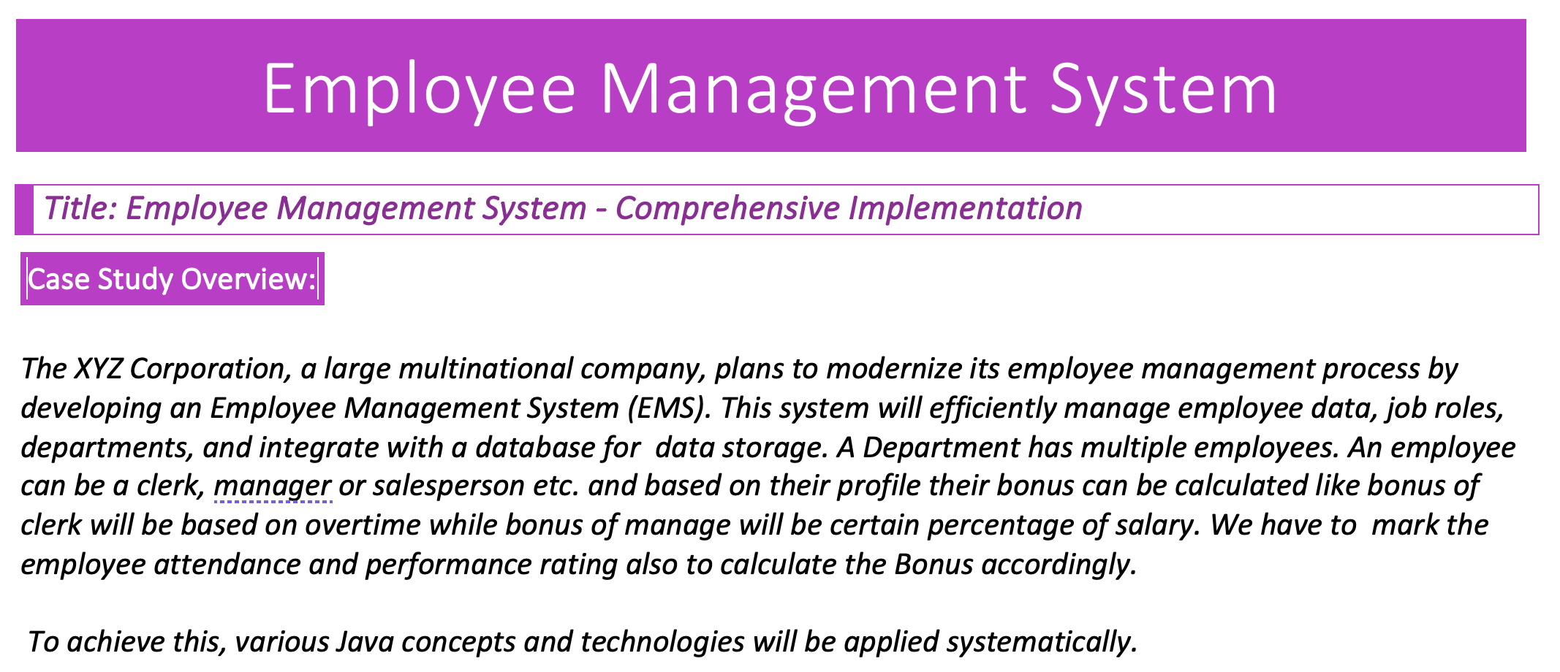
Case Study Reference

Slide 6
Take Break of 15 mins

Slide 7
Identify the entities
Employee
Department
Clerk
Manager
SalesPerson

Slide 8
Identify functionalities
Calculate Bonus
Employee Attendance

Slide 9
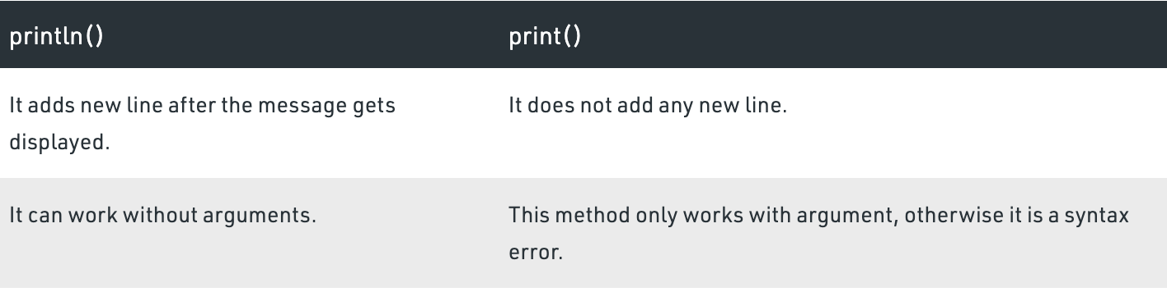
Lab: Hello Java
System.out.println()
System: It is a final class defined in the java.lang package.
out: This is an instance of PrintStream type, which is a public and static member field of the System class.
println(): As all instances of PrintStream class have a public method println(), hence we can invoke the same on out as well. This is an upgraded version of print().
Vargs…. method that takes a variable number of arguments.

Slide 10
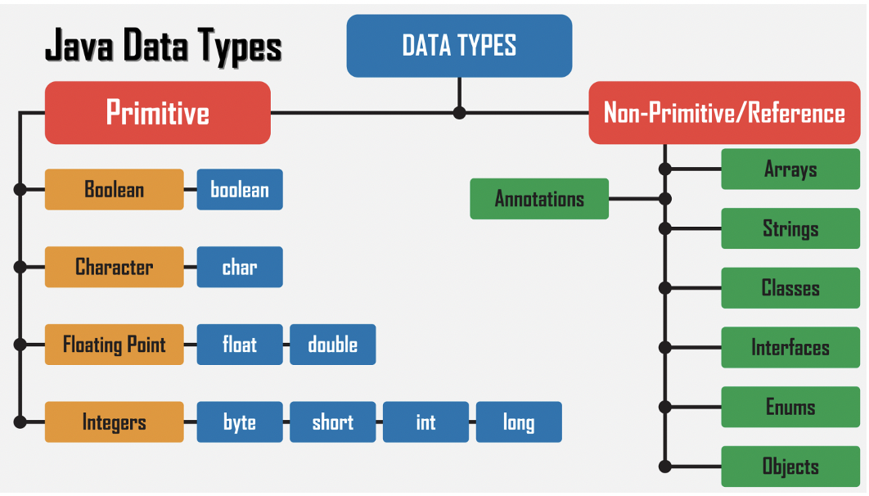
Data Type
Data types are different sizes and values that can be stored in the variable

Slide 11
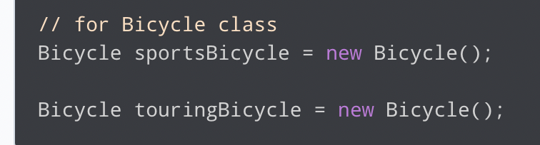
Building Block : Object
An object is any entity that has a state and behavior. For example, a bicycle is an object. It has
States: idle, first gear, etc
Behaviors: braking, accelerating, etc.

Slide 12
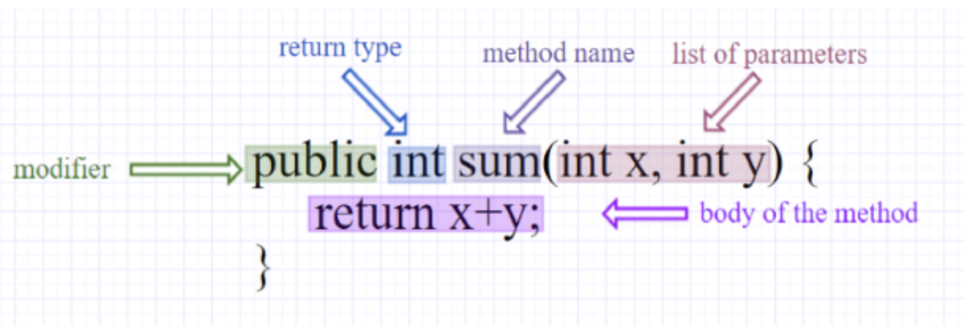
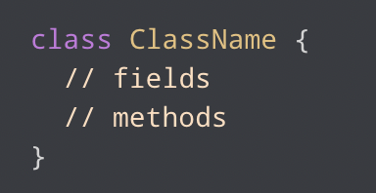
Building Block
Classes are the basic building blocks of Java programs.
A class is a blueprint for the object. Before we create an object, we first need to define the class.
fields are used to store data
methods are used to perform some operations

Slide 13
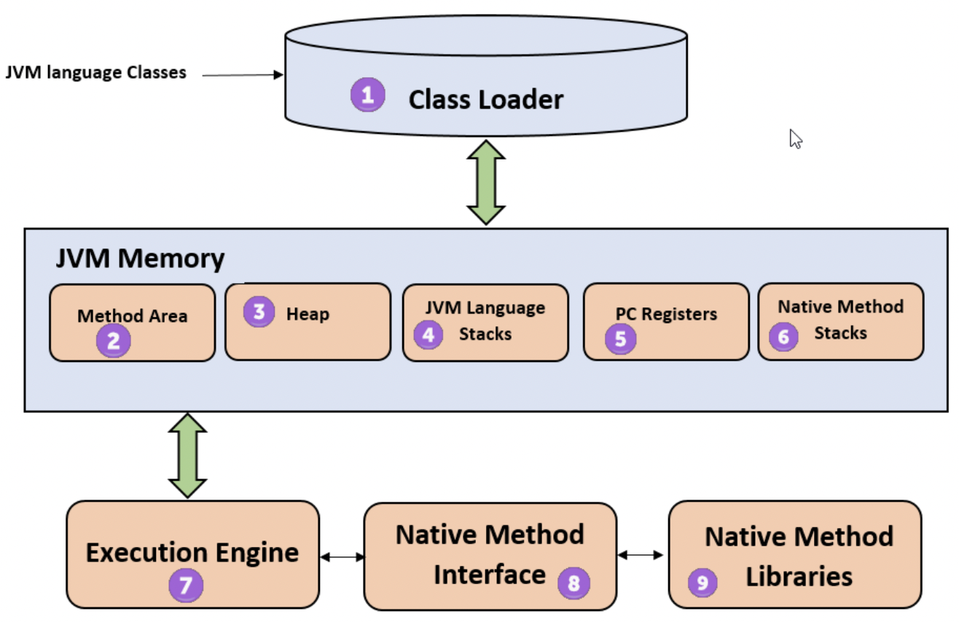
JVM Architecture
Notes:
1) ClassLoader
The class loader is a subsystem used for loading class files. It performs three major functions viz. Loading, Linking, and Initialization.
2) Method Area
JVM Method Area stores class structures like metadata, the constant runtime pool, and the code for methods.
3) Heap
All the Objects, their related instance variables, and arrays are stored in the heap. This memory is common and shared across multiple threads.
4) JVM language Stacks
Java language Stacks store local variables, and it’s partial results. Each thread has its own JVM stack, created simultaneously as the thread is created. A new frame is created whenever a method is invoked, and it is deleted when method invocation process is complete.
5) PC Registers
PC register store the address of the Java virtual machine instruction which is currently executing. In Java, each thread has its separate PC register.
6) Native Method Stacks
Native method stacks hold the instruction of native code depends on the native library. It is written in another language instead of Java.
7) Execution Engine
It is a type of software used to test hardware, software, or complete systems. The test execution engine never carries any information about the tested product.
8) Native Method interface
The Native Method Interface is a programming framework. It allows Java code which is running in a JVM to call by libraries and native applications.
9) Native Method Libraries
Native Libraries is a collection of the Native Libraries(C, C++) which are needed by the Execution Engine.

Slide 14
Class Loader
It is mainly responsible for three activities.
Loading :
.class -> binary file -> Save in method area
Linking:
Verification | Preparation | Resolution
Initialization
Notes:
Linking:
Verification: It ensures the correctness of the .class file i.e. it checks whether this file is properly formatted and generated by a valid compiler or not. If verification fails, we get run-time exception java.lang.VerifyError. This activity is done by the component ByteCodeVerifier. Once this activity is completed then the class file is ready for compilation.
Preparation: JVM allocates memory for class static variables and initializing the memory to default values.
Resolution: It is the process of replacing symbolic references from the type with direct references. It is done by searching into the method area to locate the referenced entity.
Initialization: In this phase, all static variables are assigned with their values defined in the code and static block(if any). This is executed from top to bottom in a class and from parent to child in the class hierarchy.
Bootstrap class loader: Every JVM implementation must have a bootstrap class loader, capable of loading trusted classes. It loads core java API classes present in the “JAVA_HOME/jre/lib” directory. This path is popularly known as the bootstrap path. It is implemented in native languages like C, C++.
Extension class loader: It is a child of the bootstrap class loader. It loads the classes present in the extensions directories “JAVA_HOME/jre/lib/ext”(Extension path) or any other directory specified by the java.ext.dirs system property. It is implemented in java by the sun.misc.Launcher$ExtClassLoader class.
System/Application class loader: It is a child of the extension class loader. It is responsible to load classes from the application classpath. It internally uses Environment Variable which mapped to java.class.path. It is also implemented in Java by the sun.misc.Launcher$AppClassLoader class.

Slide 15
JVM Memory
Method area: In the method area, all class level information like class name, immediate parent class name, methods and variables information etc. are stored, including static variables. There is only one method area per JVM, and it is a shared resource. From java 8, static variables are now stored in Heap area.
Heap area: Information of all objects is stored in the heap area. There is also one Heap Area per JVM. It is also a shared resource.
Stack area: For every thread, JVM creates one run-time stack which is stored here. Every block of this stack is called activation record/stack frame which stores methods calls. All local variables of that method are stored in their corresponding frame. After a thread terminates, its run-time stack will be destroyed by JVM. It is not a shared resource.
PC Registers: Store address of current execution instruction of a thread. Obviously, each thread has separate PC Registers.
Native method stacks: For every thread, a separate native stack is created. It stores native method information.

Slide 16
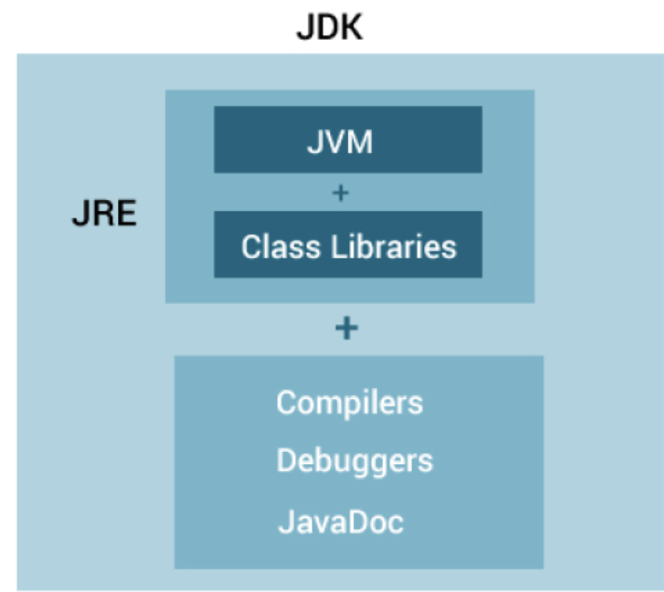
JDK vs JRE vs JVM

Slide 17
Access Specifier
1. Public
2. Private
3. Protected
4. Default(no access specifier mentioned

Slide 18
Access Specifier
Default
Private
Public
Protected
No Specifier
private
public
protected
Declarations are visible only within the package (package private)
declarations are visible within the class only
Visible everywhere
Visible within package or subclass

Slide 19
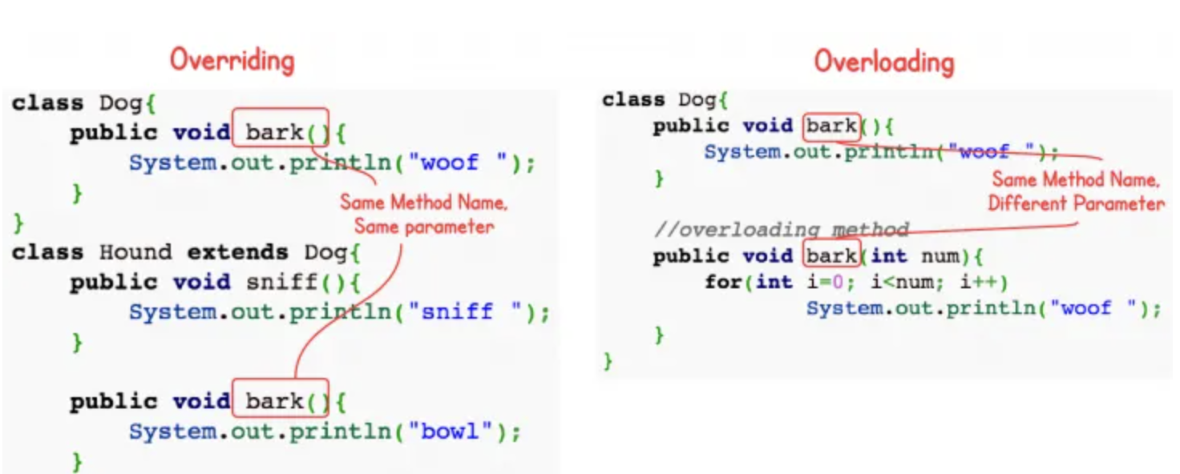
Function Overriding vs Overloading

Slide 20
Constructor
They do not have any return type.
The name of the constructor is the same as the name of the class.
Every class has a constructor. If we do not explicitly write a constructor for a class, the Java compiler builds a default constructor for that class.
Each time a new object is created, at least one constructor will be invoked.
A class can have more than one constructor.
A constructor cannot be abstract or static or final.
A constructor can be overloaded but can not be overridden.

Slide 21
Java Constructor
No Args
constructor that does not accept any arguments
Constructor
Parametized
a constructor that accepts arguments
Default
automatically created by the Java

Slide 22
Lab: Create Employee Class
Create Employee Pojo
Create Use Employee

Slide 23
Private Constructor
A real-time use case of a private constructor in Java is when implementing the Singleton design pattern.
The Singleton pattern ensures that a class has only one instance and provides a global point of access to that instance. This pattern is useful when exactly one object is needed to coordinate actions across the system.

Slide 24
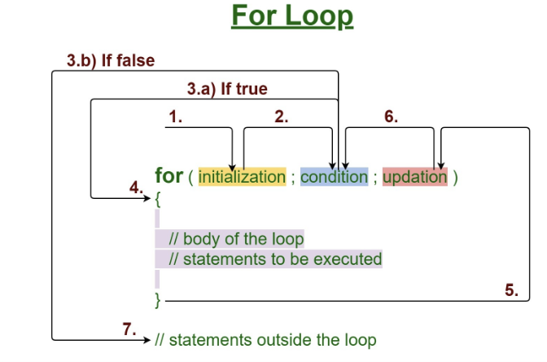
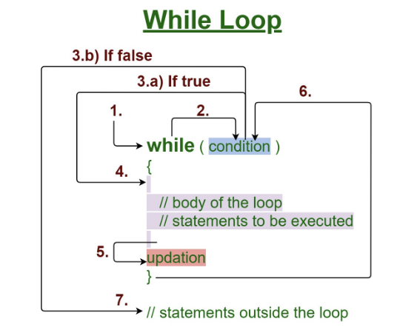
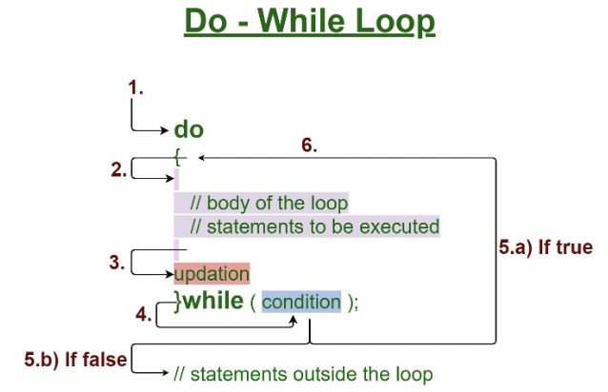
Iteration

Slide 25
Static Members
Static variables,
Static Initialization Block
Static Methods – these all are static components or static members of a class.
These static members are stored inside the Class Memory.
To access static members, you need not to create objects. Directly you can access them with class name.

Slide 26
Static Block
Static Initialization Block is used to initialize only static variables.
It is a block without a name.
It contains set of statements enclosed within { }.
2 3 4 | static { //Set Of Statements }

Slide 27
Assignment
Create 4 employee objects where user will provide name and salary and id must be generated automatically starting with 100.

Slide 28
Instructions
Stay on Camera
Only use RPS Cloud for code
No Personal Git Account
Be interactive in session
Do hands on and upload them on git on daily basis.
Join the session on time.
Attendance is recorded and tracked by team

Slide 29
Agenda
Recap
Wrapper Class
Autoboxing and unboxing
Abstract class
Interface
Inheritance

Slide 30
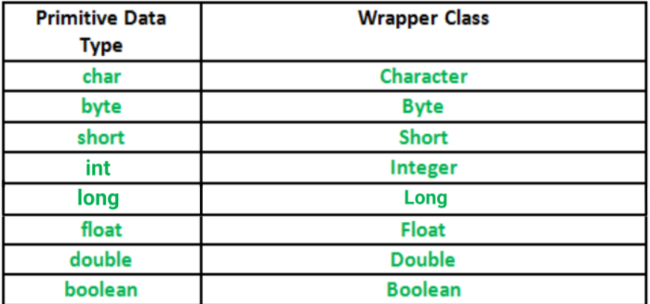
Wrapper Class
A Wrapper class is a class whose object wraps or contains primitive data types. When we create an object to a wrapper class, it contains a field and in this field, we can store primitive data types. In other words, we can wrap a primitive value into a wrapper class object

Slide 31
Wrapper Classes
A Wrapper class is a class whose object wraps or contains primitive data types.
When we create an object to a wrapper class, it contains a field and in this field, we can store primitive data types.
Why?
They convert primitive data types into objects. Objects are needed if we wish to modify the arguments passed into a method (because primitive types are passed by value).
The classes in java.util package handles only objects and hence wrapper classes help in this case also.
Data structures in the Collection framework, such as ArrayList and Vector, store only objects (reference types) and not primitive types.
An object is needed to support synchronization in multithreading.

Slide 32
AutoBoxing and Unboxing (Java 5)
Autoboxing is the automatic conversion that the Java compiler makes between the primitive types and their corresponding object wrapper classes.
int salary=50;
Integer salaryObject=new Integer(salary);//Boxing
Unboxing is automatic conversion of wrapper class type into corresponding primitive type, i
Integer salaryObject=new Integer(50);
int salary=salaryObject; //Unboxing
if(salaryObject<50000){ //unboxing internally
System.out.println(salaryObject);
}

Slide 33
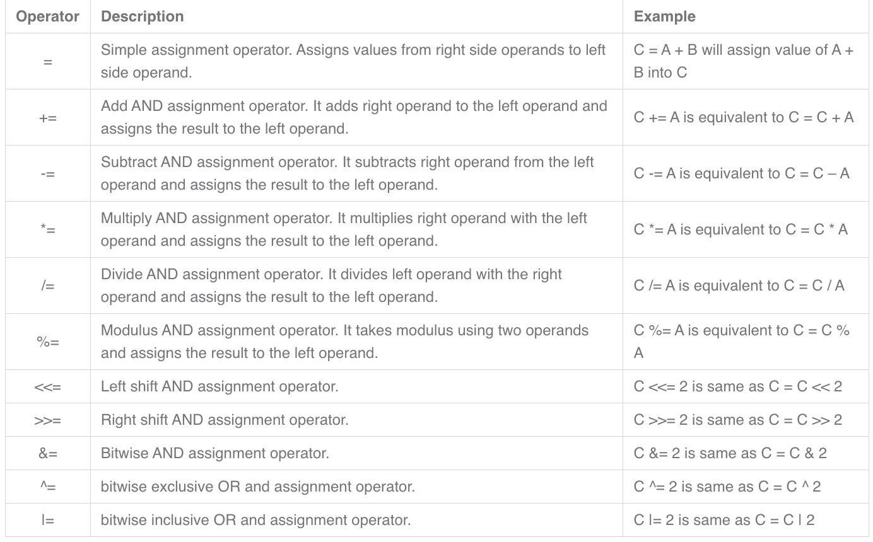
Assignment Operator

Slide 34
Abstract Class
The abstract class in Java cannot be instantiated.
An abstract class can have both the regular methods and abstract methods.
Abstract classes contain abstract methods (you can refer them as ideas) so that they can be implemented in sub classes according to their requirements.
They are also called as incomplete classes as they have some unimplemented abstract methods(ideas).
The methods which are not implemented or which don’t have definitions must be declared with ‘abstract’ keyword and the class which contains it must be also declared as abstract.

Slide 35
When to use Abstract Class
If we are using the inheritance concept since it provides a common base class implementation to derived classes.
if we want to declare non-public members.

Slide 36
Can we create an abstract Class with No abstract method?
abstract class AbstractClass
{ void methodOne()
{ //Concrete Method }
//No Abstract methods but class is abstract
}
If yes , can we create instance of abstract class
abstract class AbstractClass
{
void methodOne()
{//Concrete Method }
void methodTwo()
{//Concrete Method }
}
public class Abstraction
{
public static void main(String[] args)
{
AbstractClass a = new AbstractClass(); //Compile time error
//You can't create objects to AbstractClass
//even though it does not contain any abstract methods.
}
}

Slide 37
Interface (IS-A relationship)
The interface is a blueprint that can be used to implement a class. The interface does not contain any concrete methods (methods that have code). All the methods of an interface are abstract methods.

Slide 38
Why use Interface?
It is used to achieve abstraction.
By interface, we can support the functionality of multiple inheritance.
It can be used to achieve loose coupling.

Slide 39
When to use Interface?
when we think that the API will not change for a while.
when we want to have something similar to multiple inheritances

Slide 40
Inheritance
In java is used to add additional functionalities to the existing class. Inheritance is used to extend the present class by adding some more properties to it.
Inheritance is used to reuse the present tried and tested code so that you may not have to write them and compile them again.

Slide 41
Why need inheritance?
Code Reusability: The code written in the Superclass is common to all subclasses. Child classes can directly use the parent class code.
Method Overriding: Method Overriding is achievable only through Inheritance. It is one of the ways by which Java achieves Run Time Polymorphism.
Abstraction: The concept of abstract where we do not have to provide all details is achieved through inheritance. Abstraction only shows the functionality to the user.

Slide 42
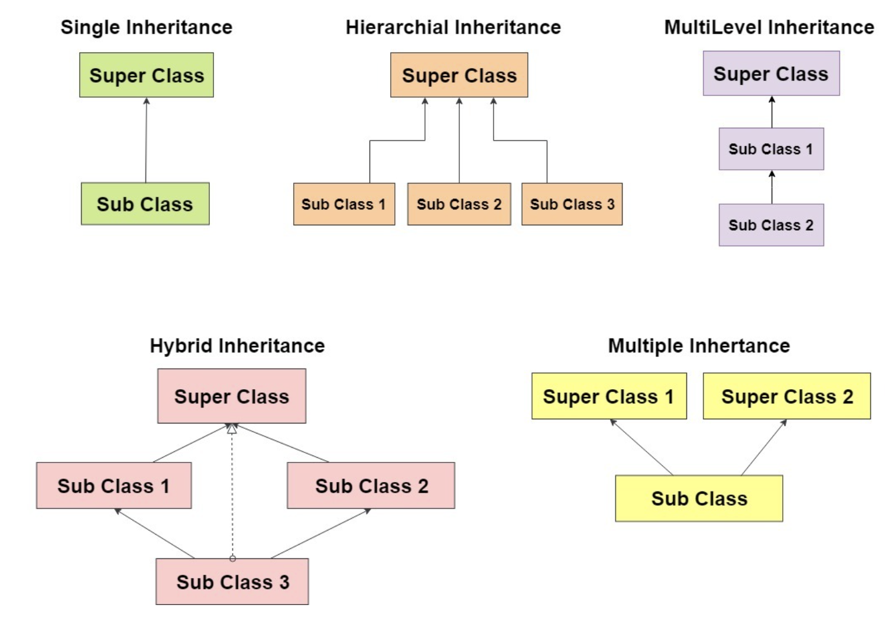
Type of Inheritance

Slide 43
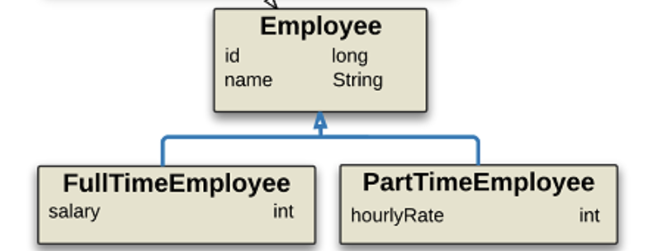
INheritance

Slide 44
Static block with Inheritance
Constructors, SIB – Static Initialization Block and IIB – Instance Initialization Block of super class will not be inheriting to its sub class. But they are executed while creating an object to sub class.

Slide 45
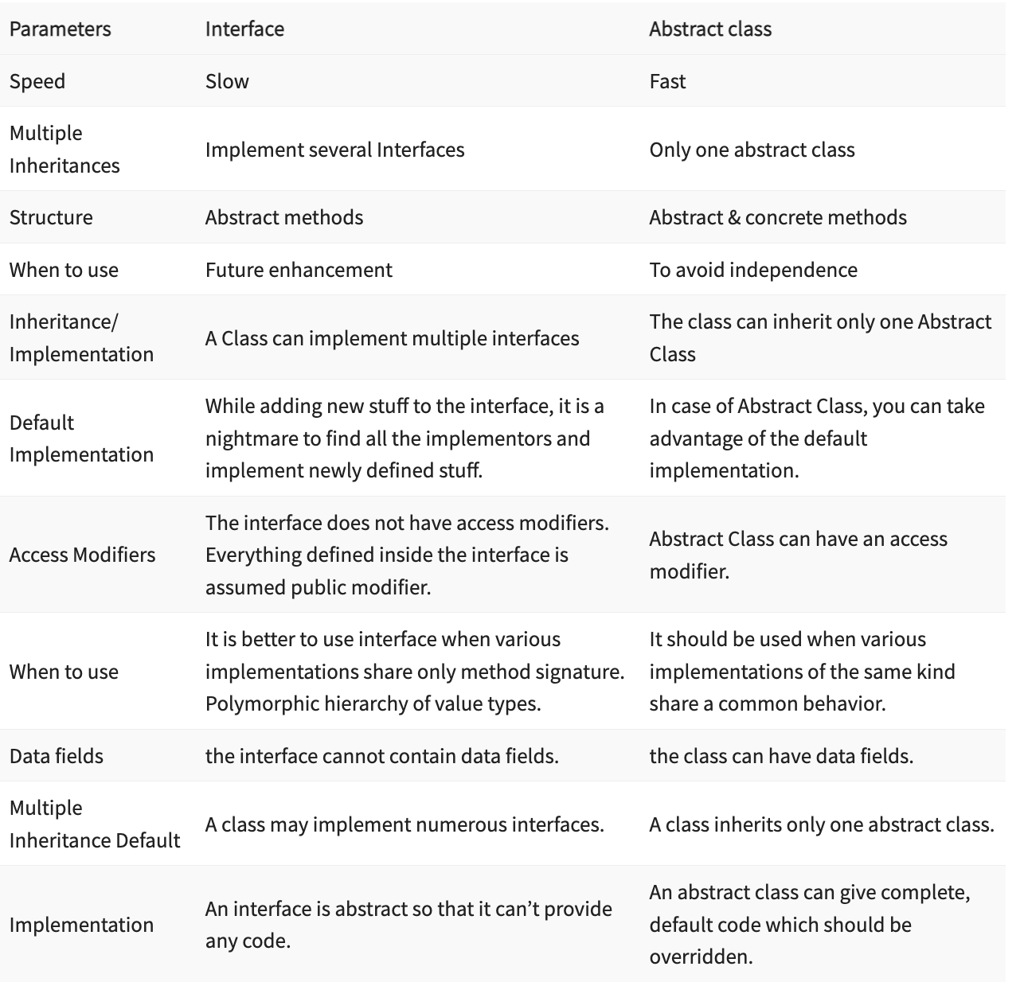

Slide 46
Diamond Problem
The diamond problem is a common problem in Java when it comes to inheritance. Inheritance is a very popular property in an object-oriented programming language, such as C++, Java, etc. There are different types of inheritance such as, single, multiple, multi-level, and hybrid inheritance. But remember that Java does not support the multiple inheritance because of the diamond problem.
What Java does not allow is multiple inheritance where one class can inherit properties from more than one class. It is known as the diamond problem.

Slide 47
Array
All arrays are dynamically allocated.
size of an array must be specified by int or short value and not long.
Arrays are stored in contiguous memory

Slide 48
Interface

Slide 49
Case Study : Library Management System
Book Management:
Each book has a unique ISBN (International Standard Book Number), title, author, date of publishing book genre, and availability status.
The system should support adding new books, updating existing book information, and removing books.
Books should be categorized by genre for easy browsing.
Member Management:
Each library member has a unique member ID, name, contact information, and borrowing history.
The system should allow librarians to add new members, update member information, and remove members.
Transaction Management:
Transactions involve borrowing and returning books.
Librarians should be able to record transactions, specifying the book and member involved, along with the date of transaction.
The system should update the availability status of books upon transaction completion.

Slide 50
Instructions
Stay on Camera
Only use RPS Cloud for code
No Personal Git Account
Be interactive in session
Do hands on and upload them on git on daily basis.
Join the session on time.
Attendance is recorded and tracked by team

Slide 51
Agenda
Exception
String
Practice exercises
QnA

Slide 52
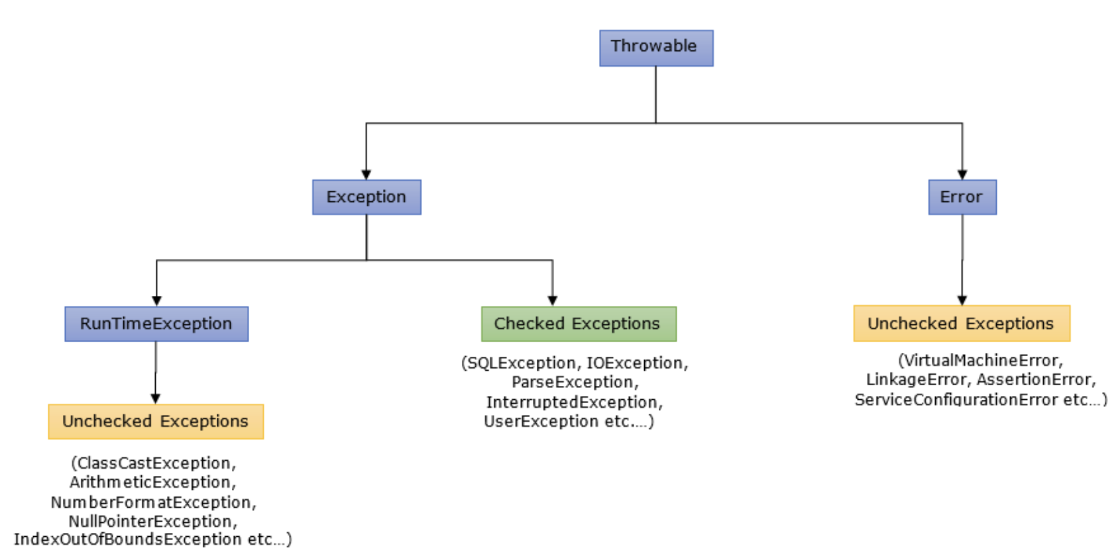
Exception
Exception is an abnormal condition which occurs during the execution of a program and disrupts normal flow of a program.
This exception must be handled properly. If it is not handled, program will be terminated abruptly.

Slide 53
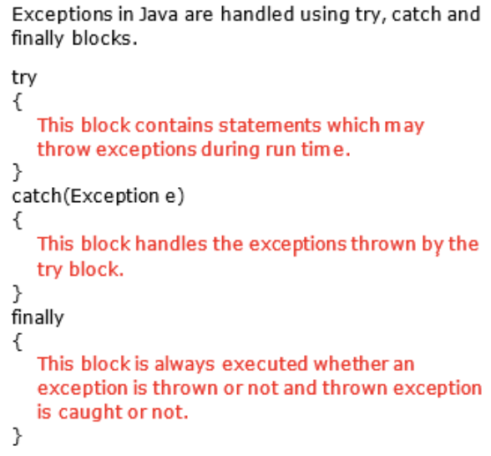
Exception Handling

Slide 54
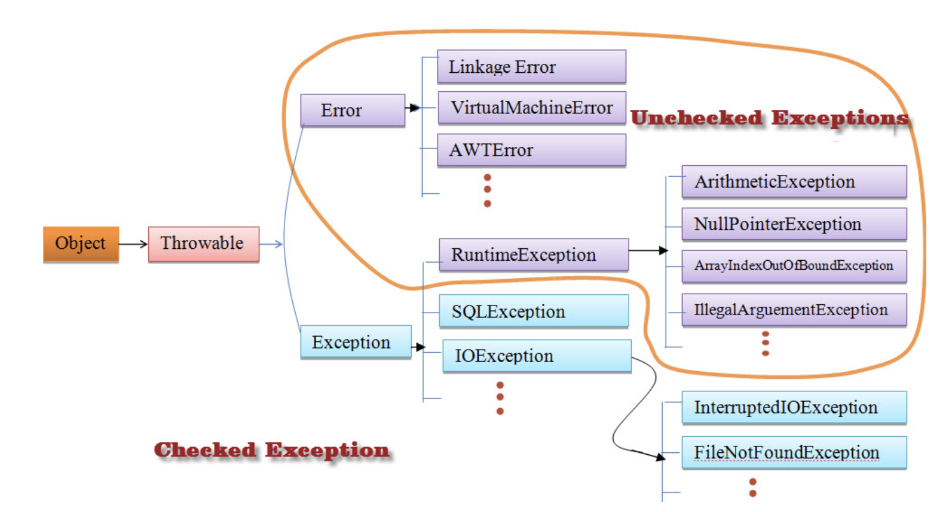
Type of Exception

Slide 55
Handle Exception
try block : The code or set of statements which are to be monitored for exception are kept in this block.
catch block : This block catches the exceptions occurred in the try block.
finally block : This block is always executed whether exception is occurred in the try block or not and occurred exception is caught in the catch block or not.

Slide 56
Lab: Credit Card Approval System
Design a program that evaluates whether a person is approved for a credit card based on the following criteria:
Minimum credit score requirement: 700
Maximum debt-to-income ratio: 30%
No recent bankruptcies (within the last 5 years)
Prompt the user to input their credit score, debt amount, income amount, and bankruptcy status, then use complex logical expressions to determine and output whether they are approved for the credit card.

Slide 57
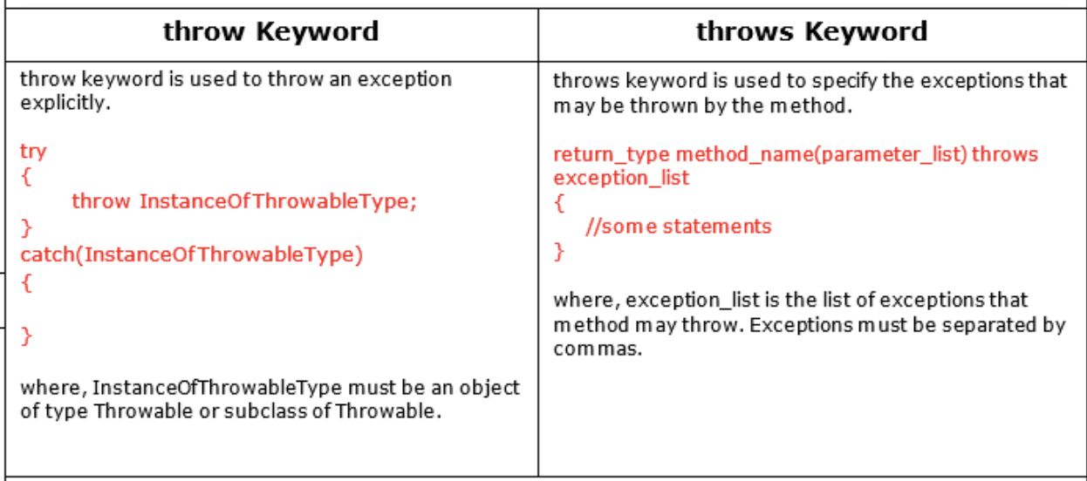
Throw and Throws

Slide 58
Error and Exception
Errors are mainly caused by the environment in which an application is running. For example, OutOfMemoryError happens when JVM runs out of memory. Where as exceptions are mainly caused by the application itself. For example, NullPointerException occurs when an application tries to access null object.

Slide 59
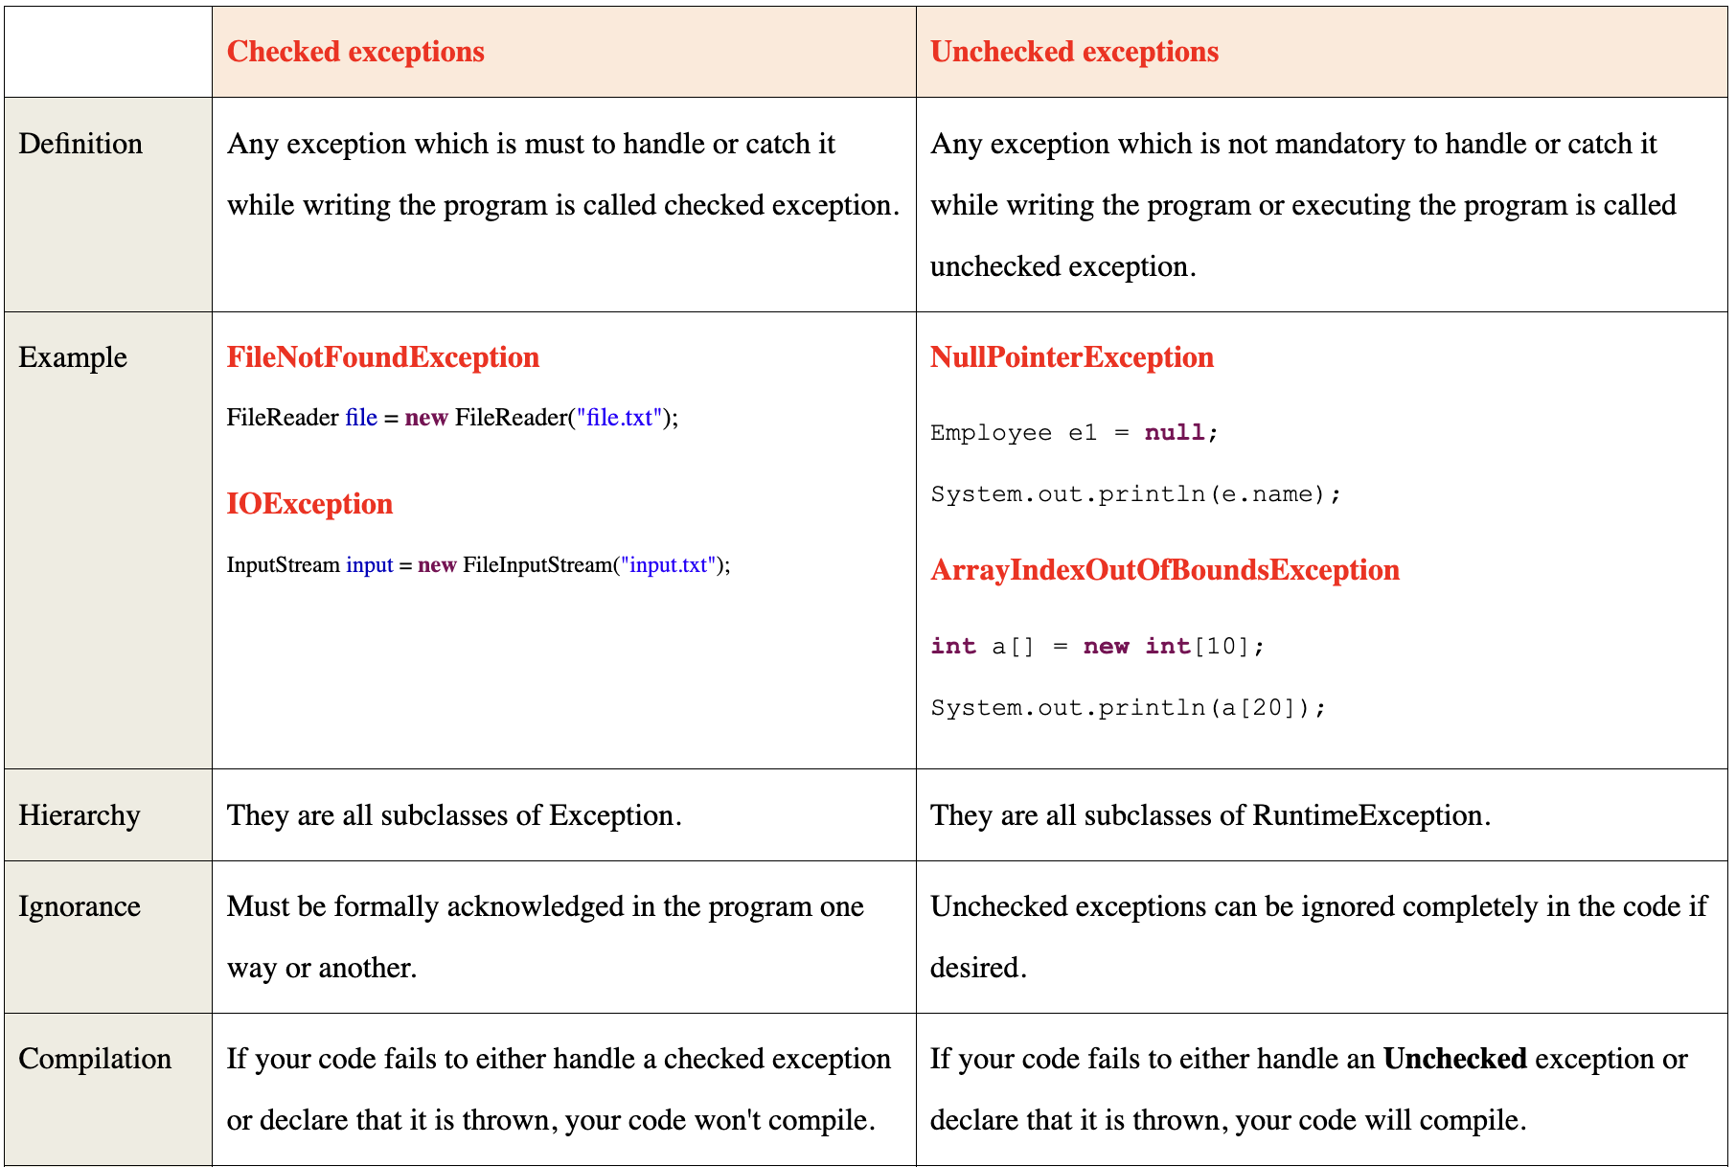

Slide 60
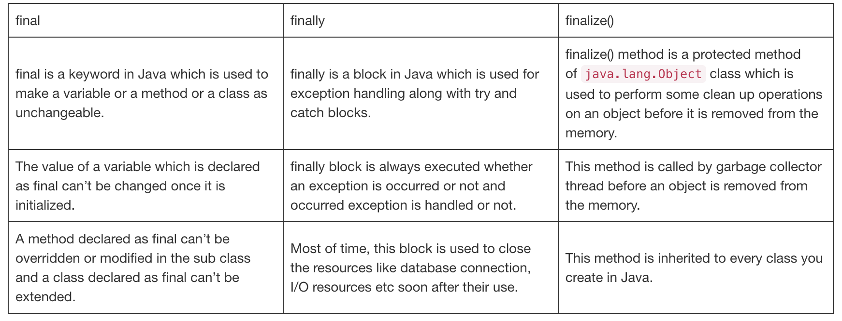

Slide 61
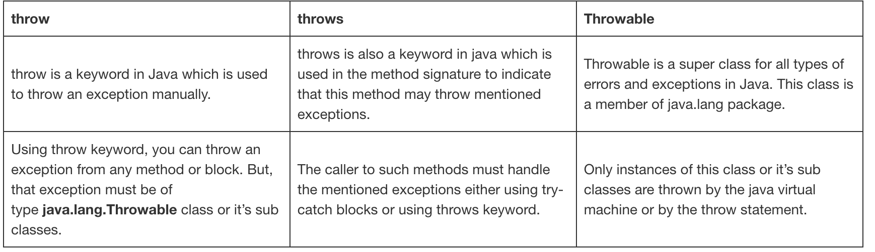

Slide 62
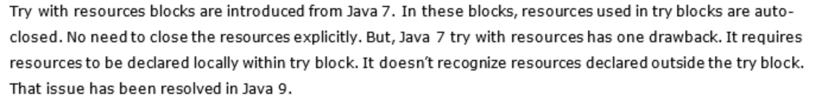
Try with Resources

Slide 63
Collection
Java Collection Framework is a framework which provides some predefined classes and interfaces to store and manipulate the group of objects. Using Java collection framework, you can store the objects as a List or as a Set or as a Queue or as a Map and perform basic operations like adding, removing, updating, sorting, searching etc.. with ease.

Slide 64
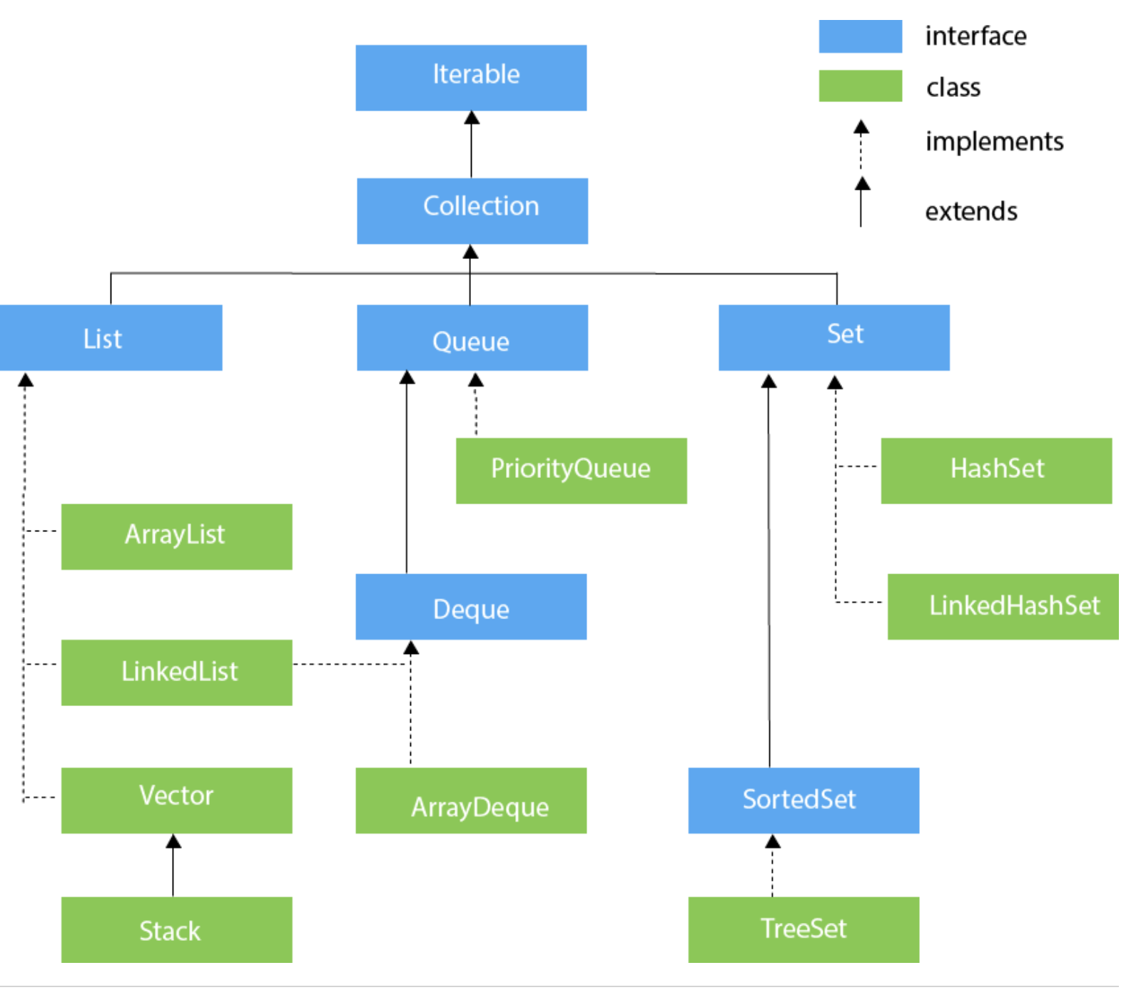

Slide 65
List
Intro :
List is a sequential collection of objects.
Elements are positioned using zero-based index.
Elements can be inserted or removed or retrieved from any arbitrary position using an integer index.
Popular Implementations :
ArrayList, Vector And LinkedList
Internal Structure :
ArrayList : Internally uses re-sizable array which grows or shrinks as we add or delete elements.
Vector : Same as ArrayList but it is synchronized.
LinkedList : Elements are stored as Nodes where each node consists of three parts – Reference To Previous Element, Value Of The Element and Reference To Next Element.
Null Elements :
ArrayList : Yes
Vector : Yes
LinkedList : Yes
Duplicate Elements :
ArrayList : Yes
Vector : Yes
LinkedList : Yes
Order Of Elements :
ArrayList : Insertion Order
Vector : Insertion Order
LinkedList : Insertion Order
When to use?
ArrayList : Use it when more search operations are needed then insertion and removal.
Vector : Use it when you need synchronized list.
LinkedList : Use it when insertion and removal are needed frequently.

Slide 66
Queue
Intro :
Queue is a data structure where elements are added from one end called tail of the queue and elements are removed from another end called head of the queue.
Queue is typically FIFO (First-In-First-Out) type of data structure.
Popular Implementations :
PriorityQueue, ArrayDeque and LinkedList (implements List also)
Internal Structure :
PriorityQueue : It internally uses re-sizable array to store the elements and a Comparator to place the elements in some specific order.
ArrayDeque : It internally uses re-sizable array to store the elements.
Null Elements :
PriorityQueue : Not allowed
ArrayDeque : Not allowed
Duplicate Elements :
PriorityQueue : Yes
ArrayDeque : Yes
Order Of Elements :
PriorityQueue : Elements are placed according to supplied Comparator or in natural order if no Comparator is supplied.
ArrayDeque : Supports both LIFO and FIFO

Slide 67
Queue
Synchronization :
PriorityQueue : Not synchronized
ArrayDeque : Not synchronized
Methods :
PriorityQueue : add(), offer(), remove(), poll(), element(), peek(), clear(), comparator(), iterator(), forEach(), contains(), spliterator()
ArrayDeque : add(), addAll(), addFirst(), addLast(), getFirst(), getLast(), offer(), offerFirst(), offerLast(), peek(), poll(), pop(), push(), contains(), remove(), removeAll(), removeFirst(), removeFirstOccurrence(), removeLast(), removeLastOccurrence(), removeIf(), size(), clear(), isEmpty(), iterator(), spliterator().
When to use?
PriorityQueue : Use it when you want a queue of elements placed in some specific order.
ArrayDeque : You can use it as a queue OR as a stack.

Slide 68
Set
Set is a linear collection of objects with no duplicates.
Set interface does not have it’s own methods. All it’s methods are inherited from Collection interface. It just applies restriction on methods so that duplicate elements are always avoided
Popular Implementations :
HashSet, LinkedHashSet and TreeSet

Slide 69
Set
Null Elements :
HashSet : Maximum one null element
LinkedHashSet : Maximum one null element.
TreeSet : Doesn’t allow even a single null element
Duplicate Elements :
HashSet : Not allowed
LinkedHashSet : Not allowed
TreeSet : Not allowed
Order Of Elements :
HashSet : No order
LinkedHashSet : Insertion order
TreeSet : Elements are placed according to supplied Comparator or in natural order if no Comparator is supplied.
Synchronization :
HashSet : Not synchronized
LinkedHashSet : Not synchronized
TreeSet : Not synchronized
When to use?
HashSet : Use it when you want only unique elements without any order.
LinkedHashSet : Use it when you want only unique elements in insertion order.
TreeSet : Use it when you want only unique elements in some specific order.

Slide 70
Set – HashSet Scenario
You want to ensure that each user ID is stored only once and can be quickly checked to prevent duplicate entries.
Here, a HashSet is highly appropriate due to its efficiency in handling uniqueness and providing constant-time complexity for common operations like adding and checking membership.

Slide 71
Set - TreeSet
You want to maintain a list of scores in a sorted order to easily get the highest, lowest, or any rank-based information.
For this purpose, TreeSet is highly appropriate because it maintains the elements in sorted order and provides efficient methods for navigation and range queries.

Slide 72
Stack
A stack is a data structure that follows the Last-In-First-Out (LIFO) principle. In Java, you can implement a stack using various methods, including using a linked list or arrays.

Slide 73
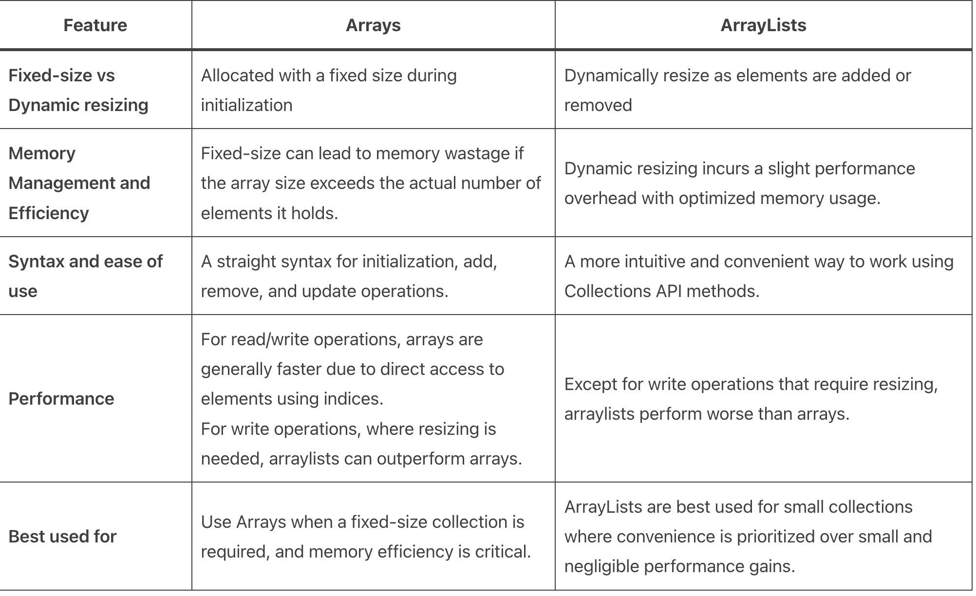
Array Vs ArrayList

Slide 74
Scenario – Choose appropriate Collection
Scenario: You are building a music player application that needs to maintain a playlist of songs. The order in which songs are added to the playlist matters because users expect to hear them in the sequence they chose.
Scenario: You are developing a system where users can register with unique usernames. The system needs to quickly check if a username already exists and prevent duplicates.
Scenario: You have a print server that needs to handle print jobs from multiple users. The server should process jobs in the order they are received, ensuring a fair and orderly processing.

Slide 75
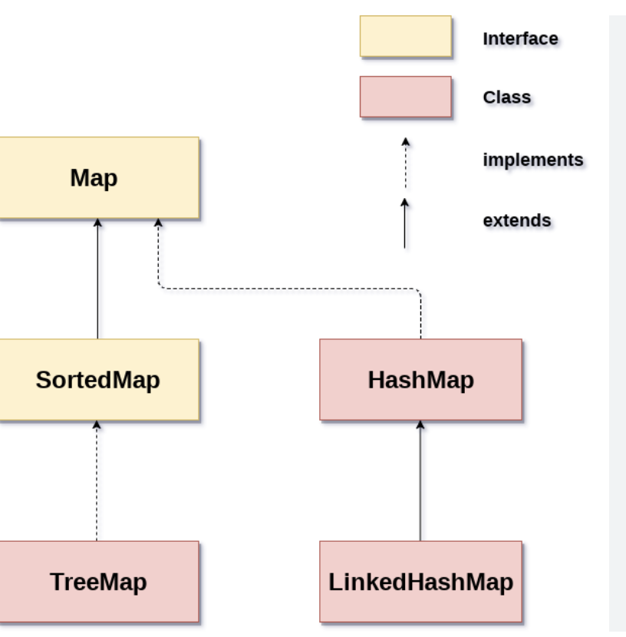
Map
Key – Value

Slide 76
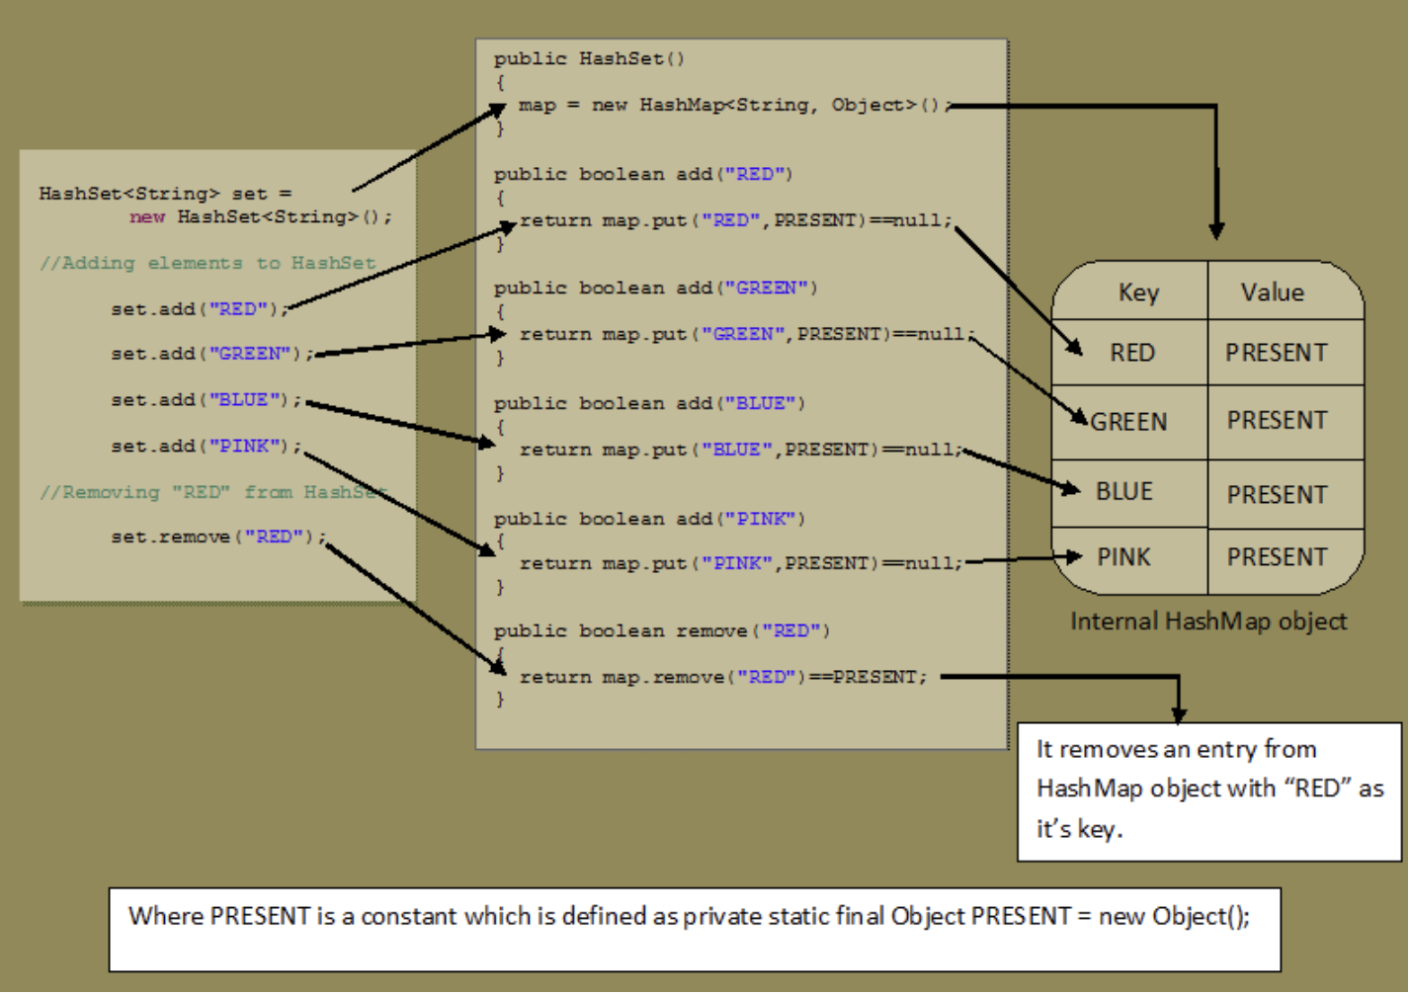

Slide 77
Generics
Generics in programming are a powerful feature that allows you to write code that is more flexible, reusable, and type-safe. They enable you to define classes, interfaces, and methods with type parameters, so you can use different types with the same code. Generics are primarily used to handle collections and other data structures in a type-safe manner.

Slide 78
Advantages of Generics
1. Type Safety
List list = new ArrayList(); list.add(123); String str = (String) list.get(0); //Not Safe
List<String> list = new ArrayList<>(); list.add("Hello"); String str = list.get(0); // Type-safe
Code Reusability
Elimination of Type Casting
Enhanced Readability
Improved Performance

Slide 79
What is Stream?
A stream is a sequence of data generated by the input source and consumed by the output destination. There are two types of I/O streams in Java.
Byte Streams
Byte streams read and write data byte by byte i.e 8 bits maximum at a time. These streams are most suitable to process the binary files like image files, audio files, video files, executable files etc…
All byte stream classes in Java are of type InputStream and OutputStream.
Character Streams
Character streams read and write data character by character. Characters in Java are from Unicode characters set and are of 16 bits in size. Hence you can say that, character streams in Java read and write data of 16 bits maximum at a time.
Character streams are mainly used to process text files.
All character stream classes in Java are of type Reader and Writer.

Slide 81
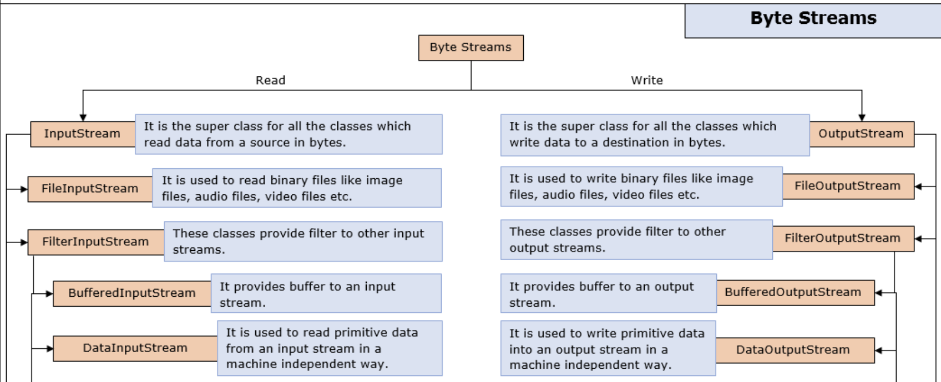
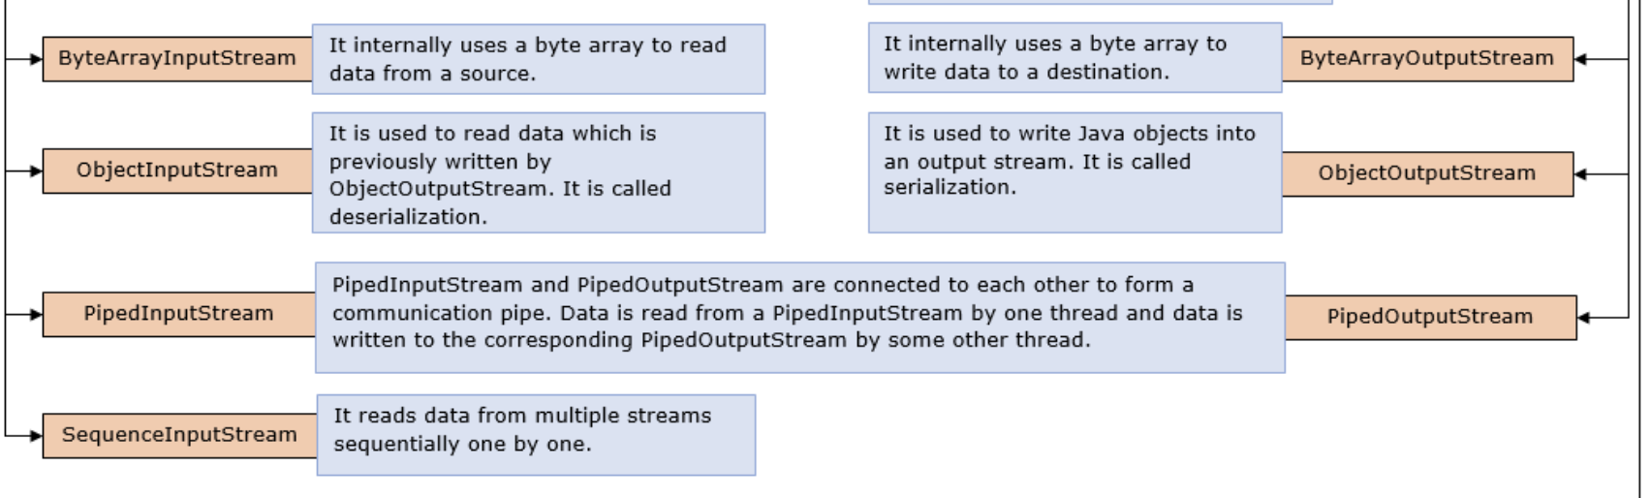
Byte Stream

Slide 82
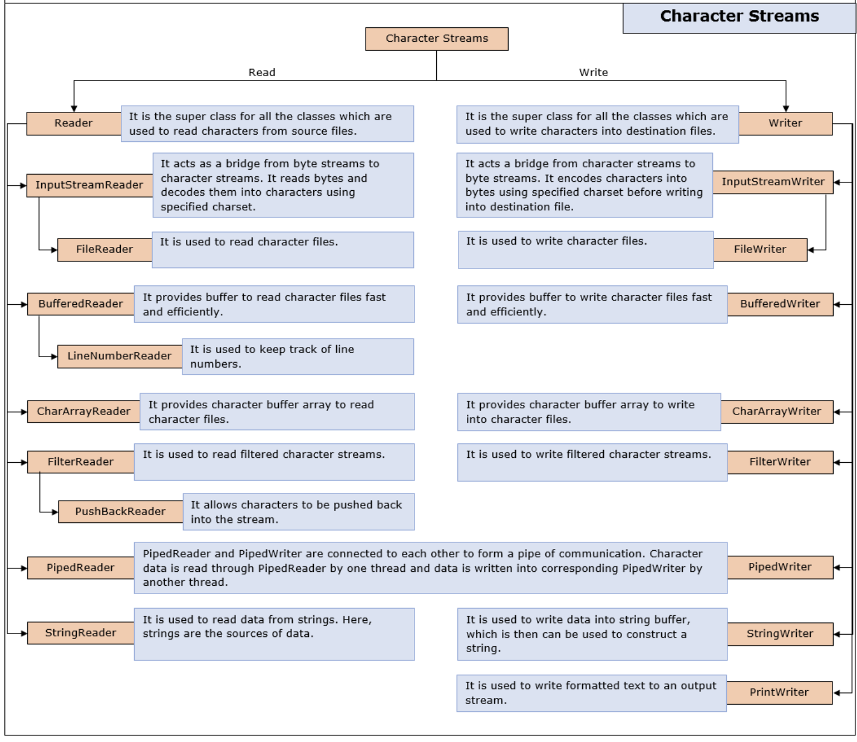
Character Reader

Slide 83
8.0 Java IO, NIO and Networking
File handling in Java can be achieved using various classes provided by the Java standard library. FileReader and FileWriter are commonly used classes for reading from and writing to files, respectively.

Slide 84
FileReader and FileWriter
FileReader is used for reading data from a file. It reads data in character form and is suitable for reading text files.
FileWriter is used for writing data to a file. It writes data in character form and is suitable for writing text files.

Slide 85
BufferedReader and BufferedWriter
BufferedReader and BufferedWriter are higher-level classes in Java that wrap around FileReader and FileWriter, respectively.
They provide efficient reading and writing operations by buffering input and output, which can enhance performance, especially for larger files.

Slide 86
File IO
File I/O (Input/Output) involves reading from and writing to files on disk. This is a common task in many programming languages and is crucial for persistent storage.
Reading from Files:
Open the file in read mode.
Read data (line-by-line, byte-by-byte, etc.).
Close the file.
Writing to Files:
Open the file in write mode (creates the file if it doesn’t exist, or truncates it if it does).
Write data to the file.
Close the file.
Modes:
Read (r): Open a file for reading.
Write (w): Open a file for writing (overwrites existing content).
Append (a): Open a file for writing (appends to existing content).
Binary (b): Open a file in binary mode (useful for non-text data).
Error Handling:
Handle potential errors such as file not found, permission issues, or I/O errors.

Slide 87
Stream and File IO
Streams are a way to handle data flow in a program. They can represent input or output of data and are typically used to handle tasks such as reading from or writing to files, network communications, or other data sources.
Types of Streams:
Input Streams: Used to read data. For example, reading from a file or receiving data over a network.
Output Streams: Used to write data. For example, writing to a file or sending data over a network.
Stream Operations:
Read/Write: Operations to get data from or send data to the stream.
Close: Always ensure you close the stream after operations to free up resources.
Buffered vs. Unbuffered:
Buffered Streams: Use a buffer to temporarily store data before performing operations. This improves efficiency.
Unbuffered Streams: Perform operations directly without intermediate storage.
Examples in Different Languages:
Java: Uses classes like FileInputStream, FileOutputStream, BufferedReader, and BufferedWriter.
Python: Uses functions and objects like open(), read(), write(), and context managers (with).

Slide 88
Serialization
Serialization is the process of converting an object's state into a format that can be easily stored (e.g., in a file) or transmitted (e.g., over a network).
The serialized format can be binary, text-based (like JSON or XML), or a custom format.
Purpose:
To persist data so it can be retrieved later.
To send data between systems or processes in a standardized format.
Common Formats:
Binary: Efficient and compact, but not human-readable.
JSON: Text-based, human-readable, and widely used in web applications.
XML: Text-based, human-readable, and often used for configuration files and data exchange.

Slide 89
Deserialization
Deserialization is the reverse process of serialization: converting the stored or transmitted data back into its original object form.
Purpose:
To retrieve and reconstruct the original data from a stored or transmitted format.
Allows for the reuse and manipulation of saved objects.

Slide 90
How to choose the Java file io appraoch ?
Byte Streams (InputStream/OutputStream):
Use byte streams when dealing with binary data, such as images, videos, or any non-textual data.
They are more efficient for reading/writing large amounts of data.
Not suitable for reading/writing text-based files directly.
Character Streams (Reader/Writer):
Use character streams when dealing with text-based data, such as text files.
They handle character encoding automatically, making them suitable for text-based data in different encodings.
They are less efficient for reading/writing binary data compared to byte streams.
Buffered Streams (BufferedReader/BufferedWriter):
Use buffered streams to improve performance by reducing the number of IO operations.
They buffer data in memory before writing it to the underlying stream, reducing disk access.
Suitable for reading/writing text-based files when performance is important.
File Streams (FileInputStream/FileOutputStream):
Use file streams when you need low-level access to files, such as reading/writing binary data directly from/to files.
They provide methods for reading/writing bytes from/to files and do not perform any character encoding.
File Readers/Writers:
Use file readers/writers when you need to read/write text-based data from/to files.
They handle character encoding automatically and are more convenient for working with text-based files compared to byte streams.
Object Streams (ObjectInputStream/ObjectOutputStream):
Use object streams when you need to serialize Java objects to binary data and vice versa.
They allow you to write entire objects to a file and read them back, preserving their state.
Suitable for saving/loading complex data structures or application state to/from files.

Slide 91
Java NIO
Java NIO (New Input/Output) is a set of APIs introduced in Java 1.4 to provide more efficient and scalable I/O operations compared to the traditional I/O classes (java.io). NIO offers non-blocking I/O operations, improved performance, and more flexible ways to handle file and network operations.

Slide 92
Features of NIO
Non-blocking I/O:
Allows you to perform I/O operations without blocking the thread, enabling more scalable applications.
Achieved using Selector with Channel.
Direct Buffers:
Direct buffers can be allocated outside of the Java heap and can be used for faster I/O operations.
Example: ByteBuffer.allocateDirect(1024);
Channel-based I/O:
Channels are more versatile than traditional streams, supporting both read and write operations, and can be used with buffers for more efficient data transfer.
File Systems and Path Operations:
java.nio.file provides a more powerful and flexible API for file system operations compared to the older java.io.File.

Slide 93
Key Components of Java NIO
Buffers:
Channels:
Selectors:
Paths and Files:

Slide 94
NIO -Buffer
Buffers are containers for data. They are used to read from and write to channels.
Key classes: ByteBuffer, CharBuffer, IntBuffer, etc.

Slide 95
NIO- Channel
Channels represent connections to I/O devices such as files, network sockets, or pipes. They can be used for both reading and writing.
Key classes: FileChannel, SocketChannel, ServerSocketChannel, DatagramChannel.

Slide 96
NIO - Selector
Selectors provide a way to monitor multiple channels for events (e.g., data available, connection ready). This is crucial for non-blocking I/O operations.
Key class: Selector

Slide 97
NIO – Path and Files
The java.nio.file package introduces the Path and Files classes for file operations, offering a more modern API compared to java.io.File.
Key classes: Path, Files

Slide 98
Java Networking
Java networking enables communication between programs on different computers connected over a network. The core components for networking in Java include Socket, ServerSocket, URL, and InetAddress.
These classes allow for various network operations, such as creating client-server applications, handling URLs, and resolving hostnames.

Slide 99
Keywords
Socket: Used for client-side operations to establish a connection with a server and communicate over it.
ServerSocket: Used for server-side operations to listen for incoming connections from clients.
URL: Represents a Uniform Resource Locator (URL) and provides methods to interact with resources located at that URL.
InetAddress: Represents an IP address and provides methods to resolve hostnames to IP addresses and vice versa.

Slide 100
9.0 Java 8 Date and Time API
Working with LocalDate, LocalTime, LocalDateTime
Temporal Adjusters, Periods, and Time Zones

Slide 101
Working with LocalDate, LocalTime, LocalDateTime
Key classes in this package include LocalDate, LocalTime, and LocalDateTime.
These classes are part of the new Date and Time API that replaces the older java.util.Date and java.util.Calendar classes with more robust and user-friendly functionality.
LocalDate: Represents a date without a time zone, e.g., 2024-08-08.
LocalTime: Represents a time without a time zone, e.g., 15:30:00.
LocalDateTime: Represents a date and time without a time zone, e.g., 2024-08-08T15:30:00

Slide 102
Temporal Adjusters, Periods, and Time Zones
Help in performing complex date-time calculations and managing different time zones.
Temporal Adjusters
Temporal Adjusters provide a way to adjust dates and times in a flexible manner. They are used with classes like LocalDate, LocalTime, and LocalDateTime to perform common date-time adjustments.
Periods
Periods represent a period of time in terms of years, months, and days. They are used to add or subtract periods from a date.
Time Zones
Time Zones handle the offset from UTC and daylight saving time adjustments. Java's ZonedDateTime and OffsetDateTime classes, along with ZoneId, help in managing and converting between time zones.

Slide 103
Basic Concepts of Multithreading
Programs, processes, and threads
Operating systems today can run multiple programs at the same time. For example, you’re reading this article in your browser (a program) but you can also listen to music on your media player (another program).
Processes are what actually execute the program. Each process is able to run concurrent subtasks called threads.
Threads are sub-tasks of processes and if synchronized correctly can give the illusion that your application is performing everything at once. Without threads you would have to write one program per task, run them as processes and synchronize them through the operating system.

Slide 104
Thread
A thread is a fundamental unit of execution within a process. Threads allow a program to perform multiple tasks concurrently by sharing the same resources, such as memory and file handles, while executing independently.

Slide 105
Thread State
State | Description
New | Thread has been created but not yet started.
Runnable | Thread is ready to run and is waiting for CPU time.
Blocked | Thread is waiting for a monitor lock to enter a synchronized block or method.
Waiting | Thread is waiting indefinitely for another thread to perform a particular action.
Timed Waiting | Thread is waiting for a specified amount of time.
Terminated | Thread has finished execution and is no longer active.

Slide 106
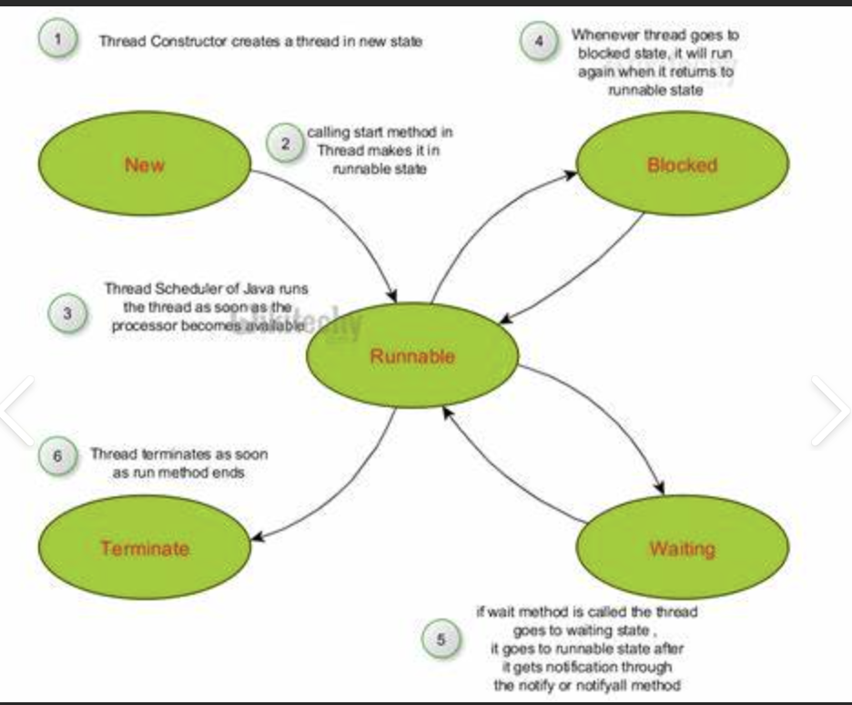
Lifecycle of Thread

Slide 107
Single Thread
Single threading refers to the execution of tasks using a single thread of execution within a process. In a single-threaded application, only one thread is active at any given time, meaning that only one task can be executed at a time.
Simplicity
Single Path of Execution
Sequential Processing
Resource Utilization

Slide 108
MultiThreading
Multithreading is a programming concept that allows a single process to have multiple threads of execution running concurrently. Each thread represents a separate path of execution and can run independently of others. Multithreading is used to perform multiple tasks simultaneously within a single program, improving performance and responsiveness.
Improved Performance
Responsiveness
Resource Sharing
Simplified Program Structure

Slide 109
2 Way to Threads
Extends by Thread
Implements Runnable

Slide 110
Inter-thread communication
Inter-thread communication in Java involves threads interacting with each other to coordinate and synchronize their operations. Java provides built-in mechanisms to facilitate this communication, primarily through the use of wait(), notify(), and notifyAll() methods

Slide 111
Methods
wait(): Causes the current thread to wait until another thread invokes notify() or notifyAll() on the same object.
notify(): Wakes up one of the threads that are waiting on the object's monitor.
notifyAll(): Wakes up all threads that are waiting on the object's monitor.

Slide 112
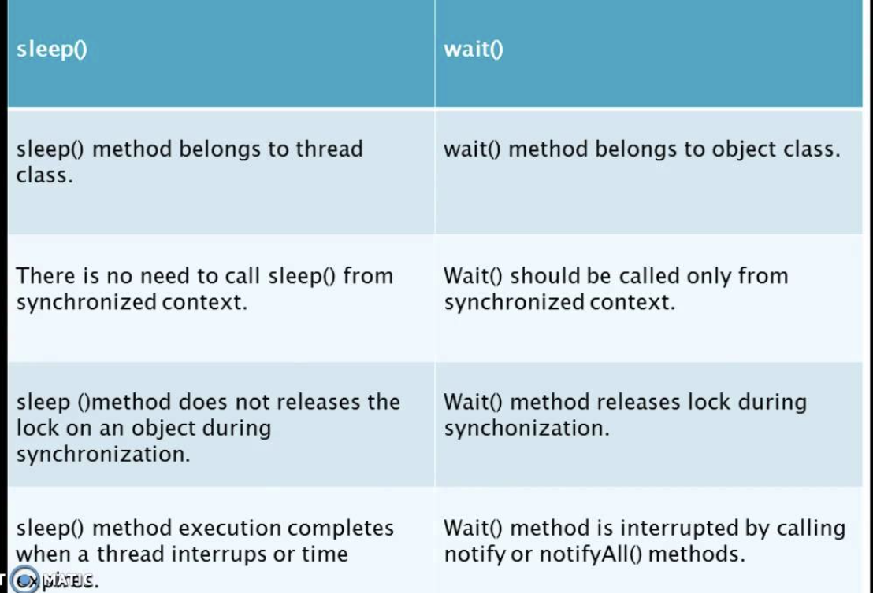

Slide 113
inter-thread communication-producer-consumer problem
Producer threads produce items and add them to a shared buffer.
Consumer threads consume items from the shared buffer.

Slide 114
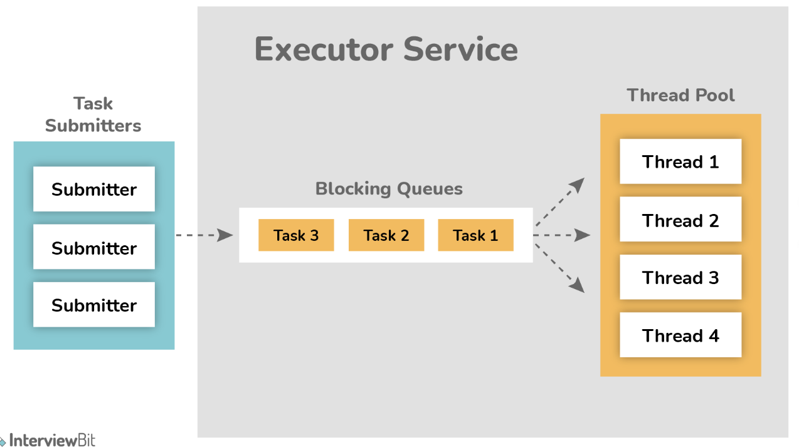
Thread Pool
A ThreadPool is a collection of worker threads that efficiently manage the execution of multiple tasks concurrently. Instead of creating and destroying threads for each task, which can be resource-intensive, a thread pool reuses a fixed number of threads to execute multiple tasks.
This can significantly improve performance and resource utilization, especially for applications that need to handle a large number of tasks or requests.

Slide 115
Why Thread Pool?
There’s no latency when a request is received and processed by a thread because no time is lost in creating a thread.
The system will not go out of memory because threads are not created without any limits
Fine tuning the thread pool will allow us to control the throughput of the system. We can have enough threads to keep all processors busy but not so many as to overwhelm the system.
The application will degrade gracefully if the system is under load.

Slide 116
ExecutorService – java.util.concurrency
ExecutorService is a high-level interface in Java that provides a framework for managing and controlling the execution of asynchronous tasks. It is part of the java.util.concurrent package and is designed to simplify the creation, scheduling, and management of threads

Slide 117
Implementations of common ExecutorService
Key Methods
newFixedThreadPool(int nThreads): Creates a thread pool with a fixed number of threads.
newCachedThreadPool(): Creates a thread pool that creates new threads as needed, but reuses previously constructed threads when available.
newSingleThreadExecutor(): Creates a single-threaded executor.
newScheduledThreadPool(int corePoolSize): Creates a thread pool that can schedule commands to run after a given delay or to execute periodically.

Slide 118
Concurrent Collection
A thread-safe variant of HashMap that supports full concurrency of retrievals and high expected concurrency for updates.
Concurrent updates and retrievals.
Better performance than synchronized HashMap.

Slide 119
CompletableFuture
CompletableFuture is a class in the java.util.concurrent package introduced in Java 8 that represents a future result of an asynchronous computation.
It provides a more powerful and flexible way to handle asynchronous programming compared to the traditional Future interface.

Slide 120
Features
Creating CompletableFuture instances
Chaining asynchronous computations
Exception handlingCombining multiple futuresWaiting for multiple futures

Slide 121
Features of CompletableFuture
Non-blocking Asynchronous Computation:
Allows you to write asynchronous code in a more readable and maintainable manner. You can chain multiple asynchronous tasks together without blocking the main thread.
Flexible Composition:
Supports a variety of methods to combine, compose, and handle multiple asynchronous tasks.
Exception Handling:
Provides ways to handle exceptions that occur during asynchronous computations.
Completion:
Allows you to complete a future manually or programmatically, giving you control over when the future should be marked as completed.

Slide 122
Thread Safety
Thread-safe code ensures that data shared between threads is accessed and modified in a way that prevents conflicts and ensures consistency.
To write thread-safe code, you can use synchronization, concurrent collections, and other concurrency utilities.

Slide 123
Key Strategies for Writing Thread-Safe Code
Synchronization
Avoiding Shared State

Slide 124
Java Memory Management -ObjectLifeCycle
Creation:
When you use the new keyword, Java allocates memory for the new object and invokes the constructor to initialize it. This marks the beginning of the object's lifecycle.
Usage:
After creation, the object can be used by calling its methods or accessing its fields. The object remains in memory as long as there are active references to it.
Reachability:
An object becomes eligible for garbage collection when there are no more active references pointing to it. This means the object is no longer needed or accessible by the program.
Garbage Collection:
Java has an automatic garbage collector that reclaims memory used by objects that are no longer reachable. This process helps in managing memory efficiently and avoiding memory leaks.
Explicit Garbage Collection:
While Java performs garbage collection automatically, you can suggest to the JVM to perform garbage collection by calling System.gc(). However, this does not guarantee immediate garbage collection.
Finalization:
Before an object is garbage collected, the finalize() method (if overridden) is called. This method can be used to release resources or perform cleanup operations.
Destruction:
After an object is no longer reachable and garbage collected, the memory allocated for the object is reclaimed. This marks the end of the object’s lifecycle.

Slide 125
Memory Leakage
Memory leaks can be a significant issue in software development, particularly in Java applications.
They occur when objects are no longer needed but are still referenced, preventing the garbage collector from reclaiming their memory.
This can lead to excessive memory consumption and degraded performance over time.

Slide 126
Common Cause – Memory Leaks
Unintentional Object Retention:
Improper Use of Caches
Thread Leak
Threads that are not properly managed or terminated can hold onto memory.

Slide 127
Memory Leakage - Tool for Analysis
Eclipse Memory Analyzer Tool (MAT)
Eclipse MAT is a powerful tool for analyzing Java heap dumps and identifying memory leaks.
Features
Leak Suspects Report: Provides insights into potential memory leaks and objects consuming the most memory.
Object Query Language (OQL): Allows custom queries to find specific objects or patterns.

Slide 128
Memory Leakage tool- VisualVM
VisualVM is a tool that provides profiling and monitoring capabilities for Java applications.
Heap Dump Analysis: Allows capturing and analyzing heap dumps to find memory leaks.
Memory Profiling: Monitors memory usage in real-time, providing insights into memory allocation and garbage collection.
Thread Monitoring: Helps in identifying thread-related issues that might contribute to memory leaks.

Slide 129
Garbage Collection
Garbage collection in Java is the process by which Java programs perform automatic memory management. Java programs compile to bytecode that can be run on a Java Virtual Machine, or JVM for short. When Java programs run on the JVM, objects are created on the heap, which is a portion of memory dedicated to the program. Eventually, some objects will no longer be needed. The garbage collector finds these unused objects and deletes them to free up memory.

Slide 130
How GC Works?
Java garbage collection is an automatic process. Automatic garbage collection is the process of looking at heap memory, identifying which objects are in use and which are not, and deleting the unused objects.
An in-use object, or a referenced object, means that some part of your program still maintains a pointer to that object.
An unused or unreferenced object is no longer referenced by any part of your program. So the memory used by an unreferenced object can be reclaimed.
The programmer does not need to mark objects to be deleted explicitly. The garbage collection implementation lives in the JVM.

Slide 131
Ways for GC?
Using System.gc() method: System class contain static method gc() for requesting JVM to run Garbage Collector.
Using Runtime.getRuntime().gc() method: Runtime class allows the application to interface with the JVM in which the application is running. Hence by using its gc() method, we can request JVM to run Garbage Collector.

Slide 132
protected void finalize() throws Throwable
The finalize() method is called by Garbage Collector, not JVM. However, Garbage Collector is one of the modules of JVM.
Object class finalize() method has an empty implementation. Thus, it is recommended to override the finalize() method to dispose of system resources or perform other cleanups.
The finalize() method is never invoked more than once for any object.
If an uncaught exception is thrown by the finalize() method, the exception is ignored, and the finalization of that object terminates.

Slide 133
GC Algo
1. Serial Garbage Collector
Suitable for applications with small heaps and minimal concurrency requirements.
Ideal for applications with small memory footprints or those running on single-core processors.Suitable for client applications where latency is not a critical concern
2. Parallel Garbage Collector (Throughput Collector)
The Parallel Garbage Collector aims to maximize throughput by using multiple threads for garbage collection.
Suitable for server applications and applications where throughput is more important than minimizing pause times.Good for applications with large heaps and multi-core environmen

Slide 134
GC Algo
Concurrent Mark-Sweep (CMS) Garbage Collector
The CMS Garbage Collector aims to minimize pause times by performing most of its work concurrently with the application threads.
It uses multiple threads to perform garbage collection with minimal impact on application responsiveness.
Suitable for applications that require low pause times and have moderate to large heaps.Good for applications where responsiveness is crucial, such as real-time systems or interactive applications.

Slide 135
GC Algo
Garbage-First (G1) Garbage Collector
The G1 Garbage Collector is designed to handle large heaps with predictable pause time goals.It divides the heap into regions and performs incremental garbage collection to balance pause times and throughput.
Suitable for applications with large heaps and where predictable pause times are important.Good for applications requiring a balance between throughput and pause time.

Slide 136
GC Algo
Z Garbage Collector (ZGC)
The Z Garbage Collector is designed for low-latency applications, aiming for minimal pause times and high scalability.It performs most garbage collection work concurrently and can handle large heaps efficiently.
Suitable for applications requiring very low pause times and those running on large heaps.Ideal for real-time or interactive applications where latency is critical.

Slide 137
GC Algo
Serial GC: Simple and single-threaded, best for small heaps and single-core systems.
Parallel GC: Multi-threaded, optimized for throughput, suitable for large heaps and multi-core processors.
CMS GC: Aims to minimize pause times with concurrent collection, good for moderate to large heaps with a focus on responsiveness.
G1 GC: Balances pause times and throughput, suitable for large heaps with predictable pause time goals.
ZGC: Provides low-latency and concurrent garbage collection, ideal for large heaps and applications requiring minimal pause times.

Slide 138
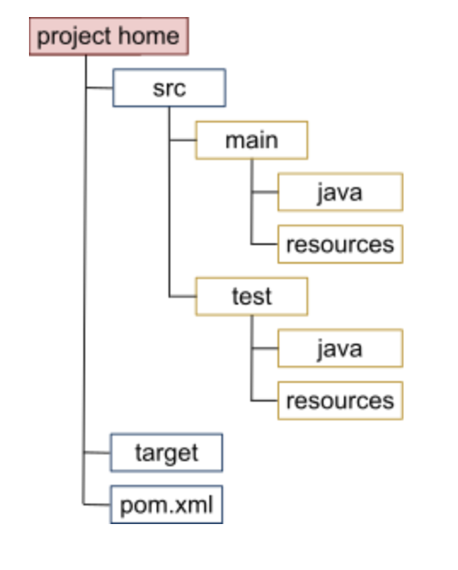
What is Maven ?
Maven is a powerful tool designed to manage the build process and dependencies of a software project.
It uses XML-based configuration files to describe the project’s structure and dependencies, providing a standardized approach to building and managing projects.

Slide 139
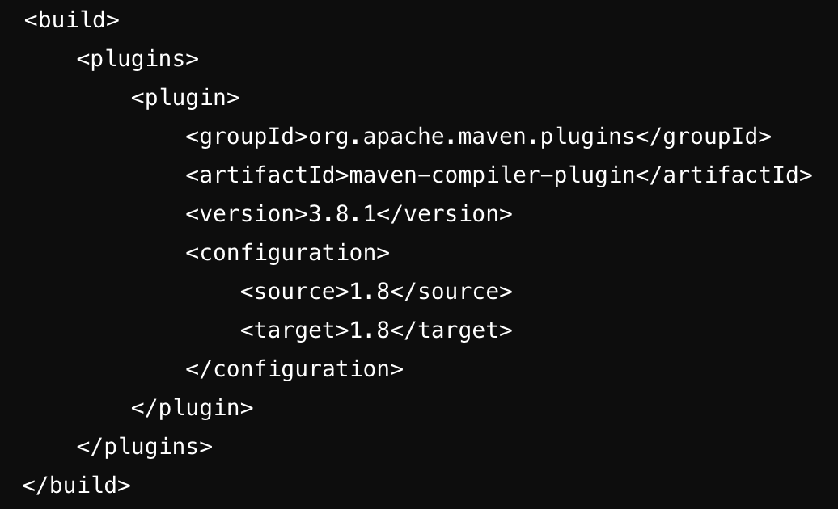
Key Concept
POM
Dependency Management
Build Lifecycle
compile: Compiles the source code.
test: Runs the tests.
package: Packages the compiled code into a JAR or WAR file.
install: Installs the package into the local repository.
deploy: Deploys the package to a remote repository.
Plugins and Goals
Maven Repository
Local Repository: A cache on the developer's machine (usually located in the .m2 directory).
Central Repository: The default remote repository provided by Maven, hosting many commonly used libraries.
Remote Repository: Custom repositories that you may configure in your pom.xml for accessing artifacts not available in the central repository.

Slide 140
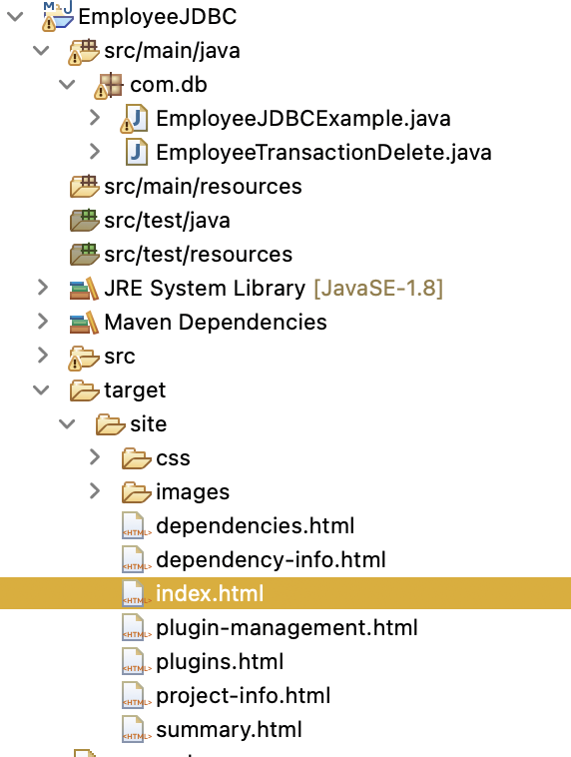
Maven Commands
mvn clean: Cleans the project by deleting the target directory.
mvn compile: Compiles the source code.
mvn test: Runs the unit tests.
mvn package: Packages the code into a JAR or WAR file.
mvn install: Installs the package into the local repository.
mvn deploy: Deploys the package to a remote repository.
mvn site : Generates documentation

Slide 141
Maven installation
https://medium.com/@j2eeexpert2015/effortless-maven-setup-a-comprehensive-installation-guide-for-java-developers-a63a357e8ae6

Slide 142
Transitive dependency and conflict resolution
In Maven, dependencies can bring along other dependencies automatically. These are called transitive dependencies.
For example, if you include library A in your project, and library A depends on library B, Maven will automatically include library B in your build.

Slide 143
Steps for Handling Transitive Dependencies and Conflict Resolution
View Dependency Tree
mvn dependency:tree
Identify and Resolve Conflicts
Check for Conflicts
Force a Version
Exclude Transitive Dependencies
Use Dependency Management
Use Dependency Analysis Tools
mvn dependency:analyze
Check Dependency Scope
compile: The default scope. Dependencies are available in all classpaths.
provided: The dependency is needed for compilation but not at runtime.
runtime: The dependency is not needed for compilation but is needed at runtime.
test: The dependency is only needed for testing.

Slide 144
JDBC

Slide 145
JDBC
Java Database Connectivity (JDBC) is an API that allows Java applications to interact with relational databases.
It provides a standard interface for connecting to and manipulating database data, making it easier to perform CRUD (Create, Read, Update, Delete) operations.

Slide 146
JDBC Key Concept
JDBC Driver: A driver that enables Java applications to interact with a specific database. Different databases require different drivers.
Connection: Represents a connection to a database. Used to create Statement, PreparedStatement, and CallableStatement objects.
Statement: Used to execute SQL queries and update statements against the database.
PreparedStatement: A Statement object that is precompiled and optimized for repeated execution. It helps prevent SQL injection attacks.
CallableStatement: Used to execute stored procedures in the database.
ResultSet: Represents the result set of a query. Provides methods to retrieve data from the result set.
Transaction Management: JDBC allows for transaction management using commit and rollback operations to ensure data integrity.

Slide 147
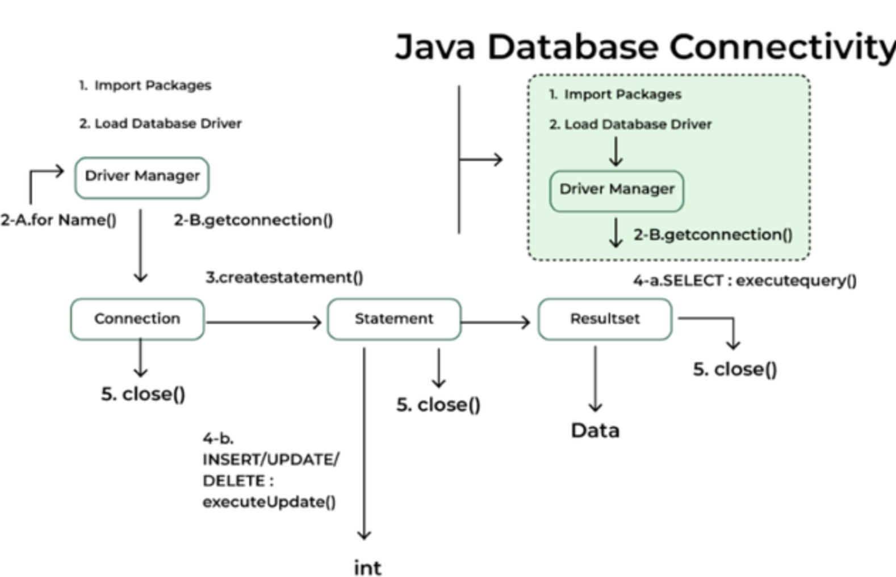
JDBC Architecture

Slide 148
Java Reflection
Java Reflection makes it possible to inspect classes, interfaces, fields and methods at runtime, without knowing the names of the classes, methods etc. at compile time.
It is also possible to instantiate new objects, invoke methods and get/set field values using reflection.

Slide 149
Annotation
Annotations in Java provide a way to add metadata to your code, which can then be processed at compile-time, runtime, or both.
There are built-in annotations provided by the Java language, and you can also define custom annotations to suit your needs.

Slide 150
Built in Annotation
@Override
@Deprecated
@SuppressWarnings
@FunctionalInterface

Slide 151
Stream
A Stream is a sequence of elements supporting sequential and parallel aggregate operations.
It allows for operations like filtering, mapping, and reducing, and is designed to work with data in a functional style.

Slide 152
Why Stream ?
Declarative Syntax: Streams allow you to write code that describes what you want to achieve rather than how to achieve it.
List<String> names = Arrays.asList("Alex", ”Johnson", "Cally");
List<String> upperCaseNames = names.stream() .map(String::toUpperCase) .collect(Collectors.toList());
Functional Programming: Streams promote a functional programming style by allowing you to use operations like map, filter, reduce, and more. This can lead to cleaner and more maintainable code.
List<Integer> numbers = Arrays.asList(1, 2, 3, 4, 5); int sum = numbers.stream() .filter(n -> n % 2 == 1) .mapToInt(Integer::intValue) .sum();

Slide 153
Why Stream?
Parallel Processing: Streams can be processed in parallel with minimal effort, allowing you to take advantage of multi-core processors.
long count = numbers.parallelStream() .filter(n -> n % 2 == 1) .count();
Pipelining: Streams support pipelining, where operations are chained together to create a sequence of transformations and computations.
List<String> filteredNames = names.stream() .filter(name -> name.startsWith("A")) .sorted() .collect(Collectors.toList());

Slide 154
Java 8
Functional Interfaces?
A functional interface is an interface that has exactly one abstract method. Java 8 introduced the @FunctionalInterface annotation to define a functional interface. Lambda expressions can be used to instantiate functional interfaces.
Lambda Expressions
Lambda expressions provide a clear and concise way to represent one method interface using an expression. They are used primarily to define the implementation of a functional interface.
Method Reference
Java provides a new feature called method reference in Java 8. Method reference is used to refer method of functional interface.
It is compact and easy form of lambda expression. Each time when you are using lambda expression to just referring a method, you can replace your lambda expression with method reference.
Steam API
The Streams API is a new abstraction introduced in Java 8 that allows you to process sequences of elements (such as collections) in a functional style. Streams support operations like mapping, filtering, and reduction.

Slide 155
Java 8
Optional
The Optional class is a container object which may or may not contain a non-null value. It is used to avoid null checks and NullPointerExceptions.
Predicate
A Functional Interface is an Interface which allows only one Abstract method within the Interface scope. There are some predefined functional interface in Java like Predicate, consumer, supplier etc. The return type of a Lambda function (introduced in JDK 1.8) is a also functional interface.
The Predicate interface represents a single argument function that returns a boolean value. It is commonly used for filtering elements in a collection or making decisions based on conditions.
In Java 8, Predicate is a functional interface, which accepts an argument and returns a boolean. Usually, it used to apply in a filter for a collection of objects.

